Slide 1



WAGE™
Workforce Alliance For Growth in the Economy

Slide 2
WAGE™ is a job readiness training program conducted by the Adult Education Division of the…

Slide 3













Offered through local Adult Education Programs

Slide 4
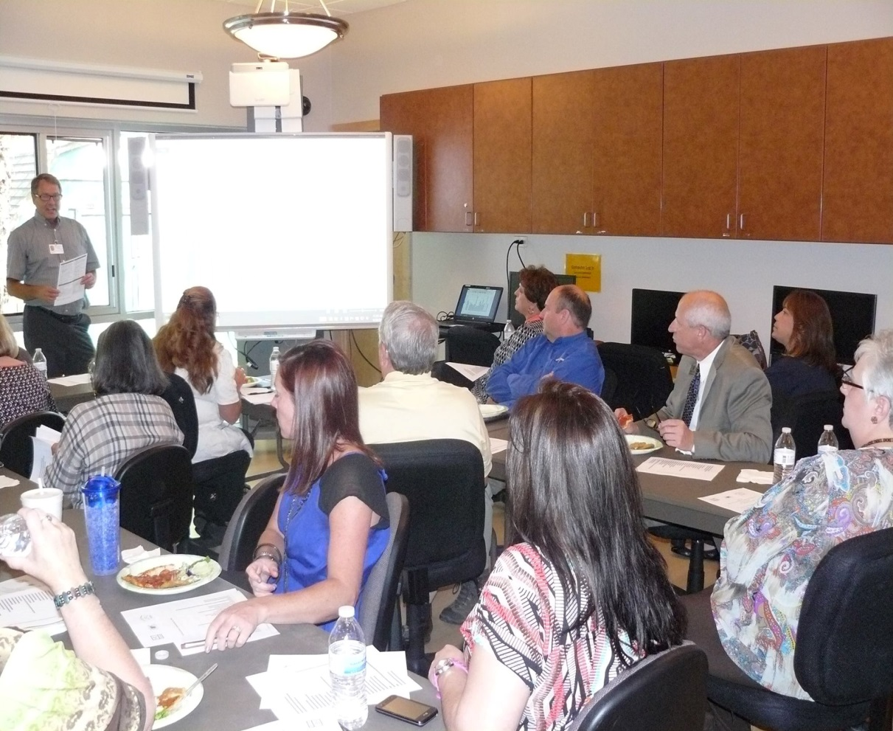
WAGE is Employer Driven
Supported by a local WAGE Advisory Committee

Slide 5
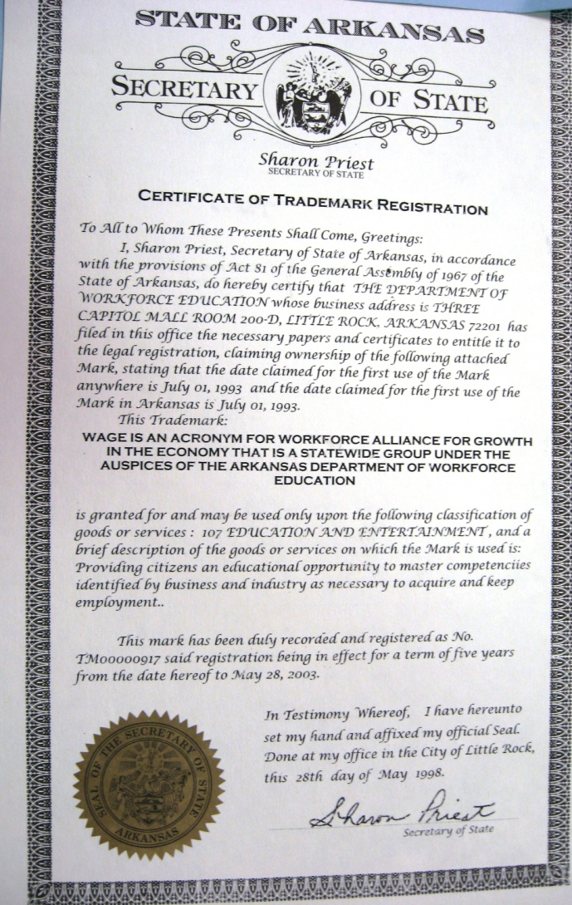
WAGE™ is Trademarked

Slide 6

Exclusive to Arkansas
Adult Education

Slide 7

All services provided by
Adult Education/WAGE™
Are
From Taxpayer Dollars

Slide 8


Began in the early 1990’s
As a Partnership Between Pulaski County Adult Education and the Maybelline Company

Slide 9

Why WAGE™ is Needed
399,755 Arkansans Lack Basic
Skills

Slide 10

Why WAGE™ is Needed
491,863 Arkansans 18 years of age or older function below…

Slide 11

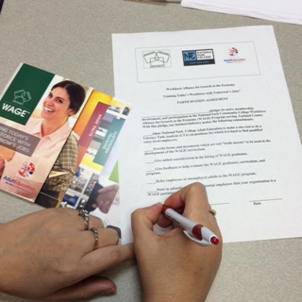
How WAGE™ Works
Employers agree to

Slide 12
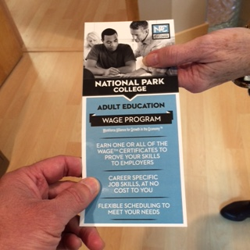
WAGE Partners/Employers Refer…
Job seekers or current employees
to earn certificates

Slide 13

Participating employers
agree to give added
consideration to WAGE™
graduates; given all other
candidate qualifications are equal.

Slide 14

Some Employers Require a WAGE™
Certificate for Hiring

Slide 16


Slide 17







The alliance also includes participation agreements with the Arkansas Department of Human Services, the Arkansas Department of Workforce Services, chambers of commerce, human resources associations, local leaders, staffing and training agencies, economic development agencies and boards, as well as other educational providers.

Slide 18



WAGE™ is based on the same alliance principles as the
Formerly
Supported by

Slide 19
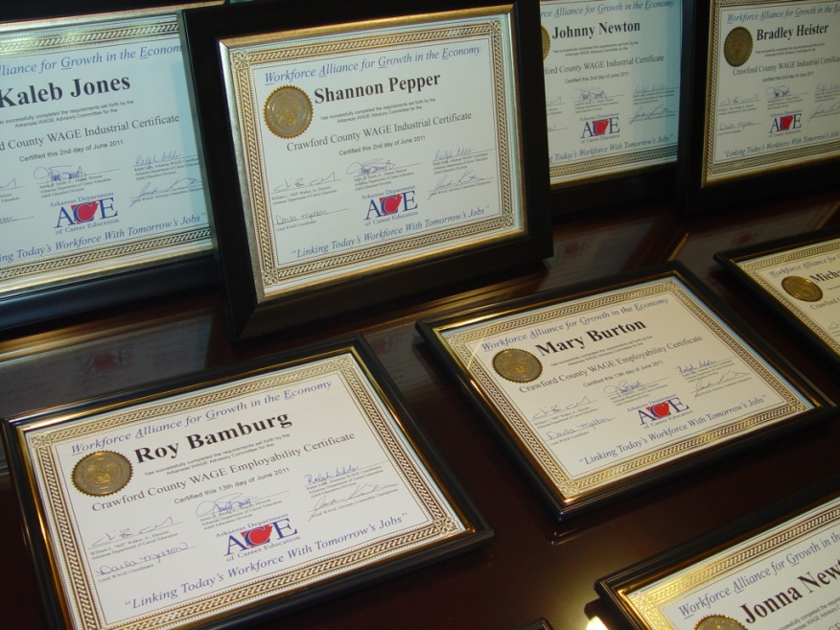
Employability
Industrial
Office Technology
Customer Service I & II
Bank Teller
WAGE™ offers
state-issued certificates.

Slide 20
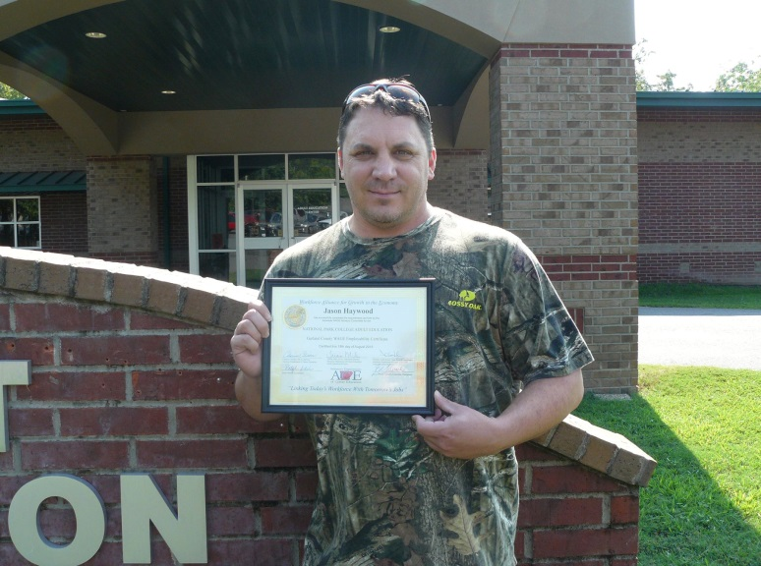
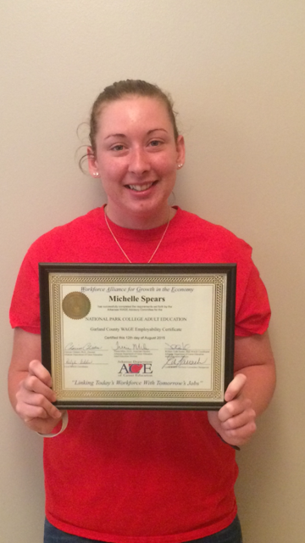

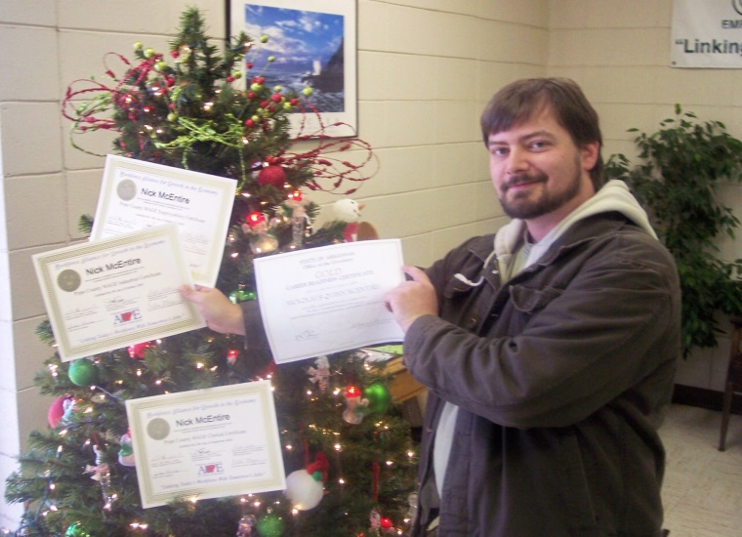

Certificates are Stackable

Slide 21
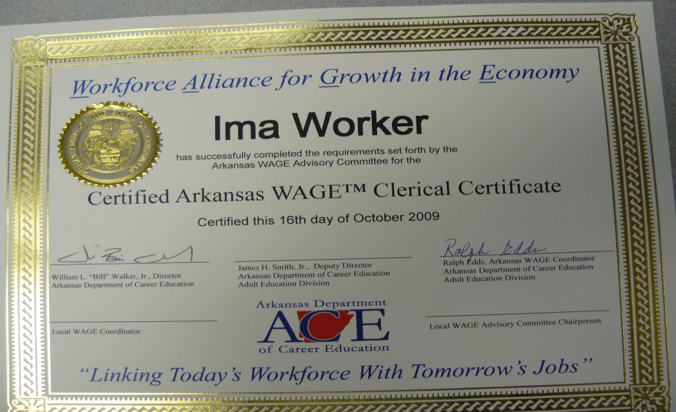



Adult Education will help student
Earn All Certificates
Employability
Industrial
Office Technology
Bank Teller
Customer Service I & II

Slide 22
WAGE Certificate Requirements Involve
Communications, Reading, Math, Writing
Computer Literacy
WAGE Test
Workplace Ethics
Teamwork
Customer Service
Keyboarding
TABE Test
Spatial Relations
Manual Dexterity
Mechanical Aptitude

Slide 23
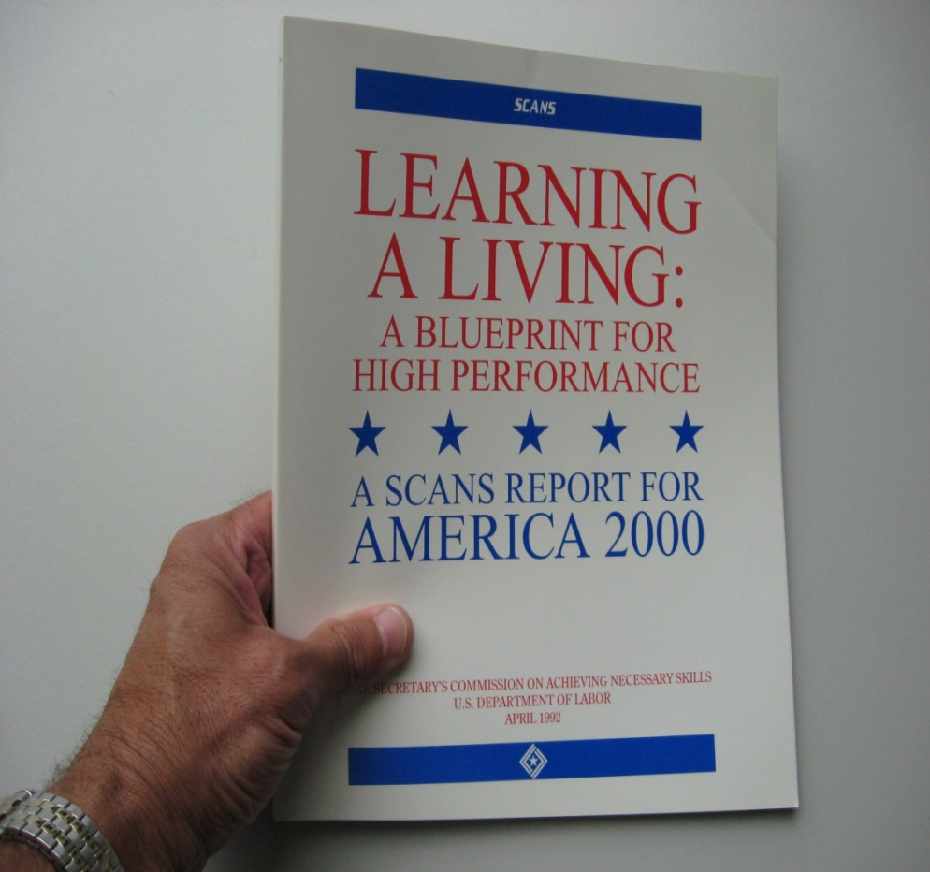
WAGE™ includes 112 basic skill competencies based on the Secretary’s Commission on Achieving Necessary Skills (SCANS)

Slide 24
Secretary's Commission on Achieving Necessary Skills
Background
In 1990, the Secretary of Labor appointed a commission to determine the skills our young people need to succeed in the world of work. The commission's fundamental purpose was to encourage a high-performance economy characterized by high-skill, high-wage employment. Although the commission completed its work in 1992, its findings and recommendations continue to be a valuable source of information for individuals and organizations involved in education and workforce development.
http://wdr.doleta.gov/SCANS/

Slide 25

Certificate Holders Must Master Competencies on Web-Based WAGE ™ Test

Slide 26




Competencies Tested on Web-Based WAGE Test
Communication
Math
Reading
Writing

Slide 27
Business Return on Investment
Productivity improvements
Improved quality
Waste reduction
Increased profits
Safety incidents reduced
Customer satisfaction improves
Employee retention rates improve
Recruitment costs reduced
Improvements in employee attitudes
Employees show more interest and success at next level of technical training
Employers more competitive

Slide 28
Community Return on Investment
Increased profits = better tax base
Increased profits = better wages
Better wages retain better employees
Better wages = increased spending power
Increased spending power benefits community through better tax base, and economic growth
Improved communities attract good businesses and good employees

Slide 29

Increased Earning Power
The average increase in wages for certificate holders who were employed before earning a WAGE certificate compared to after earning a certificate increased by 17.8% according to data obtained from the Arkansas Research Center in 2012.

Slide 30

WAGE offers
Literacy Task Analysis to Employers at No Cost

Slide 31

LTA’s identify the literacy skills needed to do a specific job

Slide 32
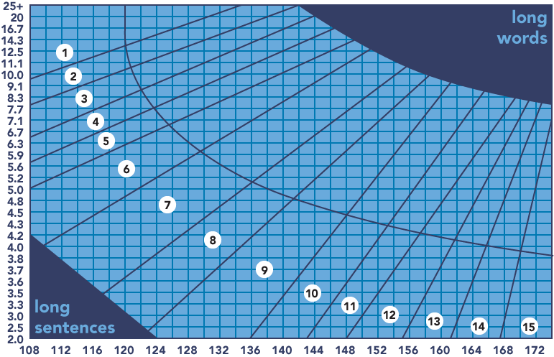
Included in the LTA—readability analysis GLE (Grade Level Equivalent) on specific company documents

Slide 33
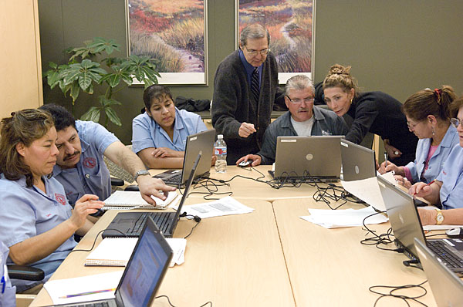
LTA Information may be used to customize specific workplace classes

Slide 34
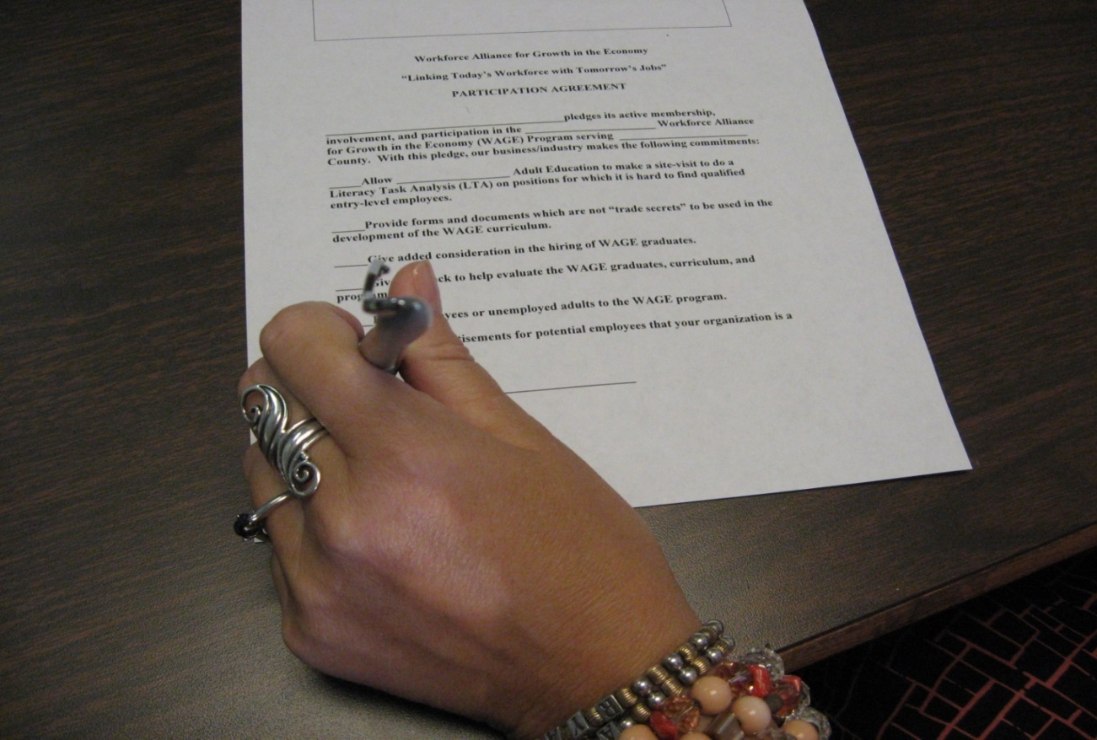
What Can I Do?
Become a Partner

Slide 35

How Can I Help?
Serve on the WAGE™ Advisory Committee

Slide 36
Refer job seekers to WAGE™

Slide 37
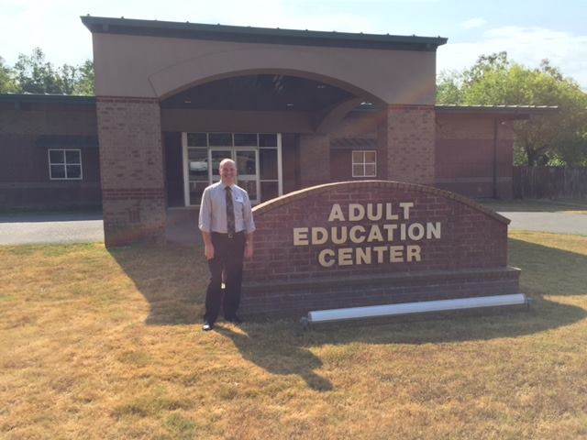
Refer to Local
Adult Education Centers

Slide 38
Contact Information
WAGE Program
Arkansas Department of Career Education
Adult Education Division
Three Capitol Mall
Little Rock, AR 72201
Phone: (501) 682-1970

