Slide 1

ARKANSAS
Adult Career Pathways: Institute 4
August 2016
Michelle Carson & Libby Livings-Eassa

Slide 2
The Contextualized Classroom

Slide 3
Welcome Back!
DAY 1 Welcome and Look Back Action Plans – Challenges & Ah-Ha’s!
The Contextualized Classroom Contextual learning as a learner Contextual teaching: research Promising practices in contextual learning Creating a contextual lesson plan Embedding & teaching employability skills Team teaching & team planning Peer review

Slide 4
Region Updates: Challenges & Ah-Ha’s

Slide 5
Roundtables: Central
Notes:
Use chart challenges and ah-ha’s

Slide 6
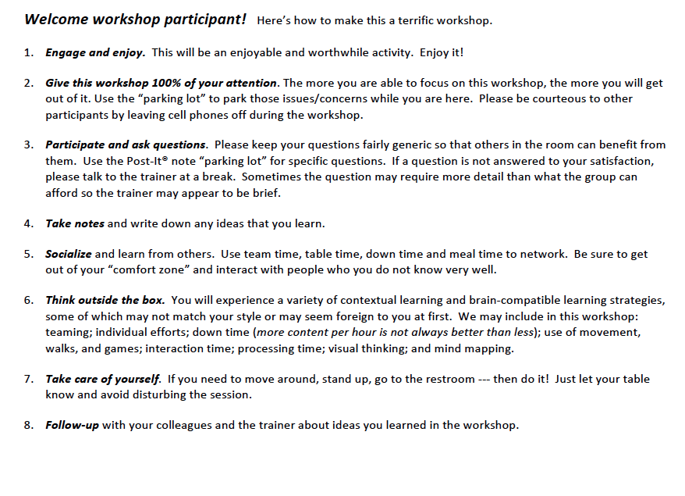
Getting the Most Out of Your Day!

Slide 7
Did you bring your lesson plan?

Slide 8
Topics
Contextual learning as a learner
Contextual teaching: research
Promising practices in contextual learning
Creating a contextual lesson plan
Peer review

Slide 9


Slide 10
Teamwork materials
The first part of this workshop will put you in the seat of a student learning in a contextualized classroom.
Before breaking into teams, we will establish some roles and provide some tools for organizing your thinking.
Go to Page 4

Slide 11
Teamwork materials
At your tables, negotiate the role you would like to take on during this exercise.
These are the roles of each team member.
If there are more of you at the table than are roles, more than 1 may be a researcher.
Leader – keeps the conversation moving and team members on task
Recorder –records the conversation and thought process, illustrates the materials to be communicated by the Reporter in the large group
Reporter – presents the teams’ solution in front of the large group
Timekeeper – is aware of the time constraints and reminds Leader of remaining time
Researcher(s) – using resources available in the room, investigate questions team members have (THERE CAN BE MORE THAN 1)

Slide 12
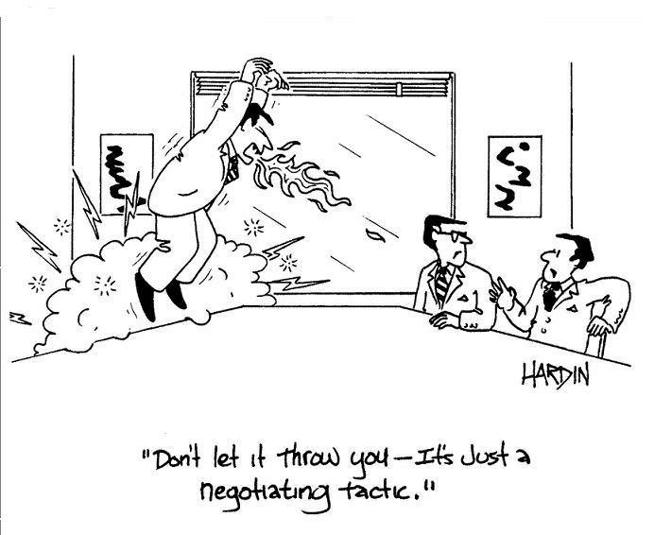
Y’all Have 5 Minutes to Negotiate Roles
Leader – keeps the conversation moving and team members on task
Recorder –records the conversation and thought process, illustrates the materials to be communicated by the Reporter in the large group
Reporter – presents the teams’ solution in front of the large group
Timekeeper – is aware of the time constraints and reminds Leader of remaining time
Researcher(s) – using resources available in the room, investigate questions team members have

Slide 13

Go to page 4 - and your scenario is . . . 1, 2, 3
We will work from a scenario -

Slide 14
DON’T READ IT YET!

Slide 15
Organizing critical thinking
Facts | Assumptions | Questions | Resources
It is important to help students organize their thinking to gain deeper understanding of the problem/project or scenario at hand.
This chart guides students to consider their own thinking (metacognition).
Let’s review each section as a student.
Use this chart in your group so you can transfer the skills back into your classroom.

Slide 16
Organizing critical thinking
Facts | Assumptions | Questions | Resources
Using the chart, identify all the facts presented from the scenario.
Remember to stick to the facts.

Slide 17
Organizing critical thinking
Facts | Assumptions | Questions | Resources
Record any assumptions you may have about the scenario that were not illustrated in the text.
Determine with your teammates if it’s an assumption or a fact.
Using the chart, identify all the facts from the scenario that are presented to you.
Remember to stick to the facts.

Slide 18
Organizing critical thinking
Facts | Assumptions | Questions | Resources
Using the chart, identify all the facts from the scenario that are presented to you.
Remember to stick to the facts.
Identify all questions you have about the scenario not addressed in the text provided.
Write those questions down in that column.
Record any assumptions you may have about the scenario that were not illustrated in the text.

Slide 19
Organizing critical thinking
Facts | Assumptions | Questions | Resources
Record assumptions you have about the scenario not illustrated in the text.
Question teammates to determine -
is it an assumption or a fact?
Brainstorm resources you could use to answer questions about the scenario.
Begin researching answers using your resources –
HINT: IPHONE OR LAPTOP
Using the chart, identify all the facts from your assigned scenario.
Remember!
Stick to the facts!
Identify all questions you have about the scenario not addressed in the text .
Write those questions down in that column.

Slide 20
Contextual learning as a learner
As a team, read the assigned scenario on Page 4 and provide solutions.
You have 25 minutes.
Sample Scenario 1 – Health Sciences
Sample Scenario 2 – Transportation,
Distribution & Logistics
Sample Scenario 3 – Marketing

Slide 21
Complete the chart
Facts | Assumptions | Questions | Resources
Record assumptions you have about the scenario not illustrated in the text.
Question teammates to determine -
is it an assumption or a fact?
Brainstorm resources you could use to answer questions about the scenario.
Begin researching answers using your resources.
Using the chart, identify all the facts from your assigned scenario.
Remember!
Stick to the facts!
Identify all questions you have about the scenario not addressed in the text .
Write those questions down in that column.

Slide 22

25 Minutes to Complete
After completing the chart,
work together to provide a solution to your scenario.

Slide 23
Organizing critical thinking
Facts | Assumptions | Questions | Resources
Record assumptions you have about the scenario not illustrated in the text.
Question teammates to determine -
is it an assumption or a fact?
Brainstorm resources you could use to answer questions about the scenario.
Begin researching answers using your resources.
Using the chart, identify all the facts from your assigned scenario.
Remember!
Stick to the facts!
Identify all questions you have about the scenario not addressed in the text .
Write those questions down in that column.

Slide 24

Tell it in 2!
Reporters come to the front of the room.
Read your assigned scenario to the group.
Share your group’s solution to the scenario in 2 minutes

Slide 25

Reflection in 5
Based on the scenario given . . .
answer the following:
What academic objectives were addressed in this experience?
What CTE objectives were addressed in this experience?
What employability skills were addressed in this experience?
Notes:
IN THEIR NOTEBOOKS

Slide 26
Flipping Out in 5
Get up from groups
Go to flip charts
Enter answers

Slide 27

Let’s Talk!
What surprised you during this experience?
What frustrated you?
Other than more time, what would you change or do differently?
Other concerns or questions?

Slide 28
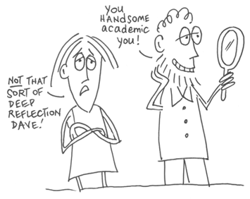
Time for self reflection . . .
Page 5

Slide 29
Identify …
Career pathway(s) illustrated
Career Pathways and content might include:
The Transportation, Distribution and Logistics Career Cluster®, Agriculture, Food and Natural Resources Career Cluster®, Business Administration Career Cluster® and Marketing Career Cluster®

Slide 30
Identify …
Academic content that could be covered
Academic content would include:
Geography and basic math concepts, such as distance calculations, profitability and mark-up costs.
Notes:
Possible integrated project/activity ideas: have a local grocer visit the classroom (or video tape him/her) about the pros and cons of purchasing locally verses purchasing from international sources. Have the students conduct a cost benefit analysis on both purchasing locally as well as from international sources. And then identify a strategy for warehousing and marketing locally produced items to meet customer demands.

Slide 31
Identify …
Technical content that could be covered
Possible integrated project/activity ideas:
Have a local grocer visit the classroom about the pros and cons of purchasing locally vs. from international sources.
Have students conduct a cost benefit analysis on purchasing locally vs. from international sources.
Then identify a strategy for warehousing and marketing locally produced items to meet customer demands.

Slide 32
What is your role within a Career Pathways system?
Facilitate learning
Support career awareness in the classroom
Help students connect concepts to real world applications
Notes:
Trainer Notes:
Ask the question of the large group: What is Your Role within a Career Pathways System?
Write down their answers on Flip-Chart Paper.
Share the slide:
Facilitate learning
Support career awareness in the classroom
Help students connect concepts to real world applications

Slide 33

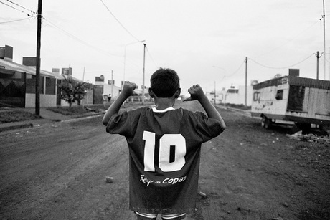


Let’s take 10?
Notes:
Hope to be at 10:30 HERE

Slide 34

What we know about how we learn
What does the research say?

Slide 35
What we know about how we learn
The brain
is a
breathtaking
instrument!

Slide 36

The brain….
It’s not just WHAT we teach, but HOW we teach it that counts.
The human brain learns BEST when concepts are taught in context AND
discards what is meaningless

Slide 37
The brain….
Let’s review samples learning theories that are best practices for classrooms.
Let’s go to PAGE 5 so you may
FILL IN THE BLANKS

Slide 38
Research
Convergence of intelligence and learning theories suggest similar methods for effective teaching and learning:
David Kolb: Individuals have a natural ability to learn through a variety of methods.
Caine & Caine: Striving for connectedness
Howard Gardner: The mind’s capacity for learning is broader than assumed

Slide 39
David Kolb
Convergence of intelligence and learning theories suggest similar methods for effective teaching and learning:
David Kolb: Individuals have a natural ability to learn through a variety of methods.
Examples?

Slide 40

“The Learning Styles Guy”
The model is based on the Experiential Learning Theory: Experiential Learning: Experience as the source of learning and development (1984).
The ELT model outlines two approaches for grasping experience:
Concrete Experience
Abstract Conceptualization
Two approaches for transforming experience:
Reflective Observation
Active Experimentation
According to Kolb, the ideal learning process engages all four of these modes.
In order for learning to be effective, all four of these approaches must be incorporated.

Slide 41
“The Learning Styles Guy”
WHAT ARE the “LEARNING STYLES?”
Convergers are characterized by abstract conceptualization and active experimentation. Good at practical applications of ideas and deductive reasoning to solve problems.
Divergers tend toward concrete experience and reflective observation. Imaginative and good at coming up with ideas and seeing things from different perspectives.
Assimilators are characterized by abstract conceptualization and reflective observation. Capable of creating theoretical models by means of inductive reasoning.
Accommodators use concrete experience and active experimentation. Good at actively engaging with the world and actually doing things instead of merely reading about and studying them.

Slide 42

Research
Convergence of intelligence and learning theories suggest similar methods for effective teaching and learning:
Caine & Caine: Striving for connectedness
Despite the individual differences in learning styles and intelligences,
all learners strive for connectedness

Slide 43

Ready for some
TESTS ?
Time for your “learn this”
activity on bottom of
page 5

Slide 44

Goin’
“old school”

Slide 45
Learn This!
E =
G =
C =
I =
F =
B =
A =
H =
D =
Caine and Caine. Making Connections: Teaching and the Human Brain.
ASCD, Alexandria, VA, 1991.

Slide 46
E = ? D = ?
I = ? C = ?
A = ? B = ?
G = ? H = ?
F = ?

Slide 47
E = ? D = ?
I = ? C = ?
A = ? B = ?
G = ? H = ?
F = ?
How did you do?
Notes:
Take you test…
Every one will squirm in their seats.
Ask for a show of hands of anyone that could get a 100%. Act disappointed….”I told you to study, I’m not curving this test”.
How do you feel? Does it look like Greek? Think about sitting in a classroom every day and the material seems to disconnected from your world.
Let’s teach this CONTEXTUALLY or the way the brain learns.
GO TO NEXT SLIDE

Slide 48

Ready to go again?
48

Slide 49
Lesson . . .
You have
5 seconds to memorize the next screen.

Slide 50
TIF
VIL
OAF
SOF
UNI
EST
MAR

Slide 51
TEST
Repeat the list to the person next to you.

Slide 52
One more try . . .

Slide 53

I would like to live
and
retire on an island.

Slide 54
Repeat the sentence to your neighbor.

Slide 55
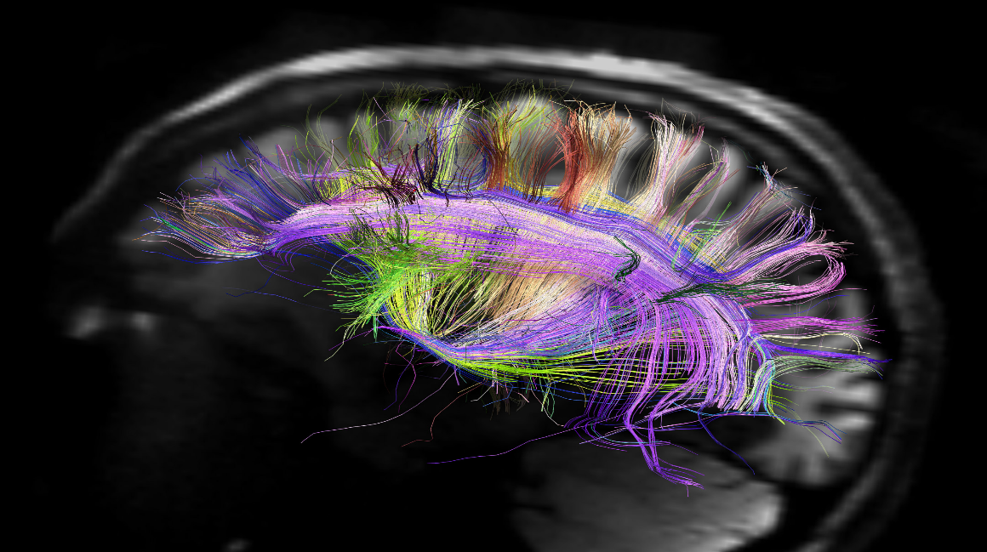
Meaning comes from INTERACTION between the individual and the material, and the CONTEXT of the use.

Slide 56
In Context
A
B
C
D
E
F
G
H
I
Caine and Caine. Making Connections: Teaching and the Human Brain.
ASCD, Alexandria, VA, 1991.
Notes:
Trainer notes:
Most of you could not recognize the word. The brain discards what it thinks is useless information.
If I gave you the new code of letters by RELATING it to a tic-tac-toe grid then your brain would connect the new information with past knowledge (tic tac toe)

Slide 57
And the answer is?
A
B
C
D
E
F
G
H
I
Notes:
Trainer notes:
Now tell me what the word is……B A D G E

Slide 58
Research
Convergence of intelligence and learning theories suggest similar methods for effective teaching and learning:
Howard Gardner: The mind’s capacity for learning is broader than assumed

Slide 59
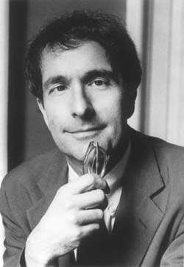
Dr. Howard Gardner, a psychologist and professor of neuroscience from Harvard University, developed the theory of Multiple Intelligences (MI) in 1983.
The theory challenged traditional beliefs in the fields of education and cognitive science.
According to Howard Gardner, human beings have 9 different kinds of intelligence that reflect different ways of interacting with the world.
Each person has a unique combination, or profile
59

Slide 60
Multiple Intelligences
Two Fundamental Principles:
Multiple Intelligence Theory: Howard Gardner, Harvard University; Frames of Mind (1983)
Intelligence is not fixed—teachers can help to develop intellectual capacity of students.
Intelligence is not unitary—everyone has some of each intelligence, forming a unique pattern of intelligences.
Notes:
PICTURE OF SYBIL

Slide 61
9 Intelligences
Go to page 6
Verbal/
Linguistic
Logical/Mathematical
Visual/Spatial
Musical/
Rhythmic
Bodily/
Kinesthetic
Interpersonal
Intrapersonal
Naturalist
Existentialist

Slide 62
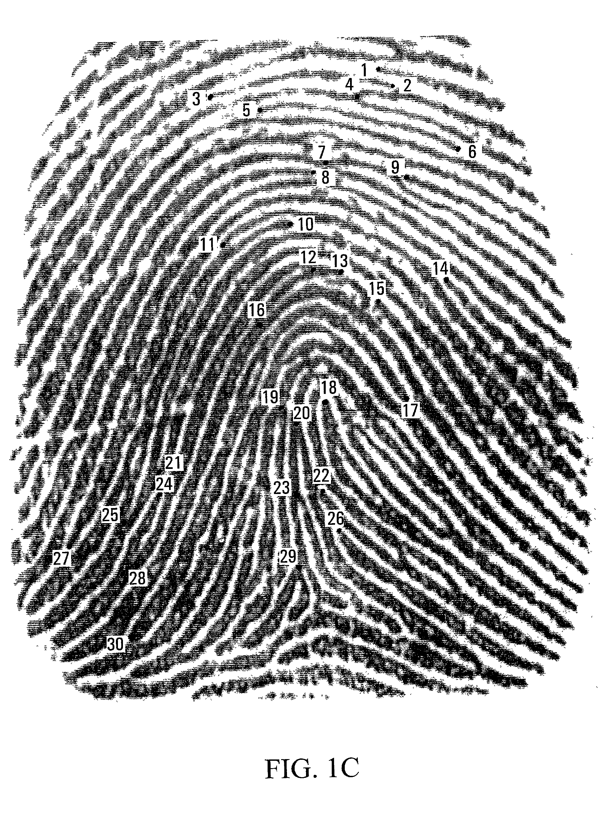
What’s Your Fingerprint?
62
Notes:
LIKE A FINGERPRINT

Slide 63

On Page 6, record your #1, #2, and #3 strongest intelligences.
63

Slide 64
What observations might you draw related to your strongest intelligence and how you currently deliver instruction?
64

Slide 65
Connecting Knowledge & Application

Slide 66
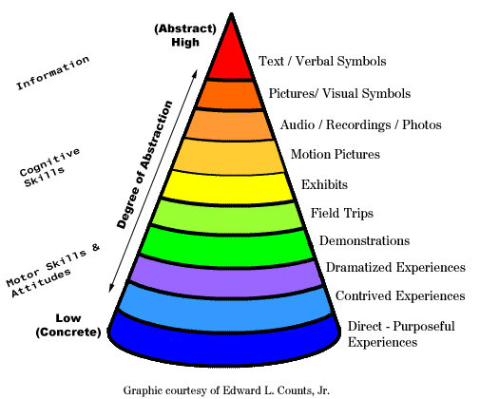
How do we reach more students?
Edgar Dale’s Cone of Experience
Page 7

Slide 67
How do we reach more students?
The Cone was originally developed by Edgar Dale in 1946.
It was intended as a way to describe various learning experiences.
The Cone shows the progression of experiences from the most concrete (at the bottom of the cone) to the most abstract (at the top of the cone)

Slide 68
Webb’s “Depth of Knowledge”
Recall
Focus is on students to work with specific facts, definitions.
Skill/Concept
Students are required to apply skills and concepts.
Strategic Thinking
Extended Thinking
Students are required to use higher order thinking.
Recall of a fact, information or procedure
Use information or conceptual knowledge, two or more steps, etc.
They must comprehend and process portions of a text; main ideas are stressed.
Items only require students to have a shallow understanding of text.
Requires reasoning, developing a plan or sequence of steps, some complexity, more than one possible answer
Students are required to use complex and abstract thinking.
They are encouraged to go beyond the text—to explain, generalize and connect ideas.
Requires an investigation, time to think and process multiple conditions of the problem
They are asked take material from one content area and apply it to another.
Notes:
Trainer Notes: http://www.aps.edu/rda/documents/resources/Webbs_DOK_Guide.pdf
Webb (1997) developed a process and criteria for systematically analyzing the alignment between standards and standardized assessments. Since then the process and criteria have demonstrated application to reviewing curricular alignment as well. This body of work offers the Depth of Knowledge (DOK) model employed to analyze the cognitive expectation demanded by standards, curricular activities and assessment tasks (Webb, 1997). The model is based upon the assumption that curricular elements may all be categorized based upon the cognitive demands required to produce an acceptable response. Each grouping of tasks reflects a different level of cognitive expectation, or depth of knowledge, required to complete the task. It should be noted that the term knowledge, as it is used here, is intended to broadly encompass all forms of knowledge (i.e. procedural, declarative, etc.).
DOK level are assigned to each course objective the following served as general guidelines for developers:
• The DOK level assigned should reflect the level of work students are most commonly required to perform
in order for the response to be deemed acceptable.
• The DOK level should reflect the complexity of the cognitive processes demanded by the task outlined by
the objective, rather than its difficulty. Ultimately the DOK level describes the kind of thinking required by
a task, not whether or not the task is “difficult”.
• If there is a question regarding which of two levels a statement addresses, such as Level 1 or Level 2, or
Level 2 or Level 3, it is appropriate to select the higher of the two levels.
• The DOK level should be assigned based upon the cognitive demands required by the central performance
described in the objective.
• The objective’s central verb(s) alone is/are not sufficient information to assign a DOK level. Developers
must also consider the complexity of the task and/or information, conventional levels of prior
knowledge for students at the grade level, and the mental processes used to satisfy the requirements
set forth in the objective.
Level 1 Recall-Recall of a fact, information or procedure. Focus is on students to work with specific facts, definitions. Items only require students to have a shallow understanding of text.
Level 2 Skill/Concept-Use information or conceptual knowledge, two or more steps, etc. Students are required to apply skills and concepts. They must comprehend and process portions of a text; main ideas are stressed.
Level 3 Strategic Thinking-Requires reasoning, developing a plan or sequence of steps, some complexity, more than one possible answer. Students are required to use complex and abstract thinking. They are encouraged to go beyond the text—to explain, generalize and connect ideas.
Level 4 Extended Thinking-Requires an investigation, time to think and process multiple conditions of the problem. Students are required to use higher order thinking. They are asked take material from one content area and apply it to another.

Slide 69
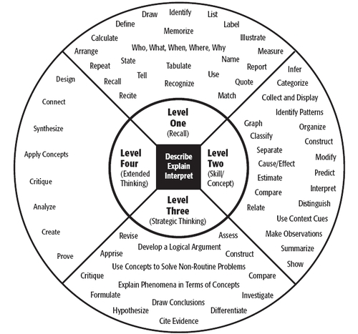
Webb’s Depth of Knowledge
  Also displayed in a
  sphere with LEVELED
  action words
  to describe the
  level
  of knowledge.

Slide 70
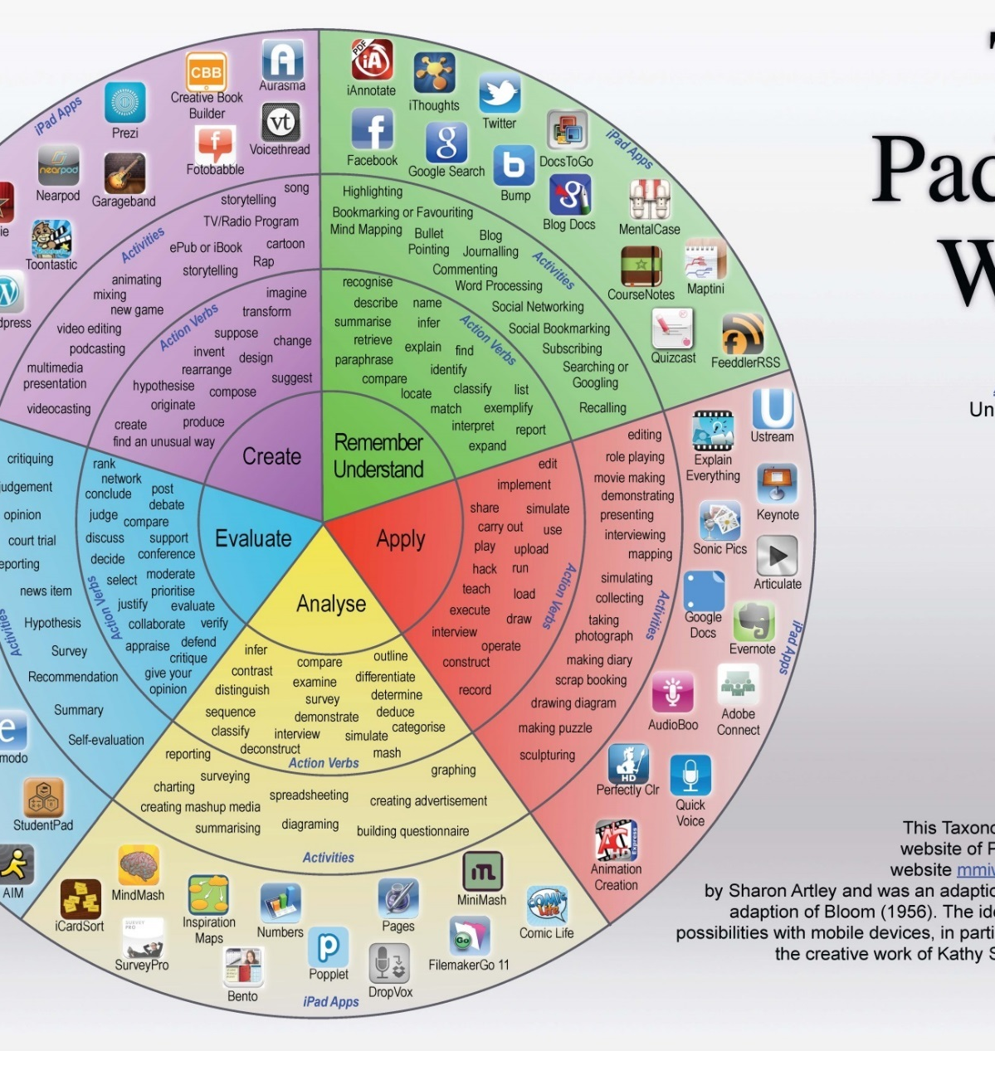
The “Pad”agogy Wheel*
Allan Carrington used Bloom’s Taxonomy to organize Web 2.0 applications that can be utilized in the classroom.
You’ll have an opportunity to redesign a lesson plan today that you brought with you today.
Consider coming back to this slide in your workbook to assess learning and checking for understanding while increasing the rigor in your classroom.
*Play on words from I pad lexicon

Slide 71
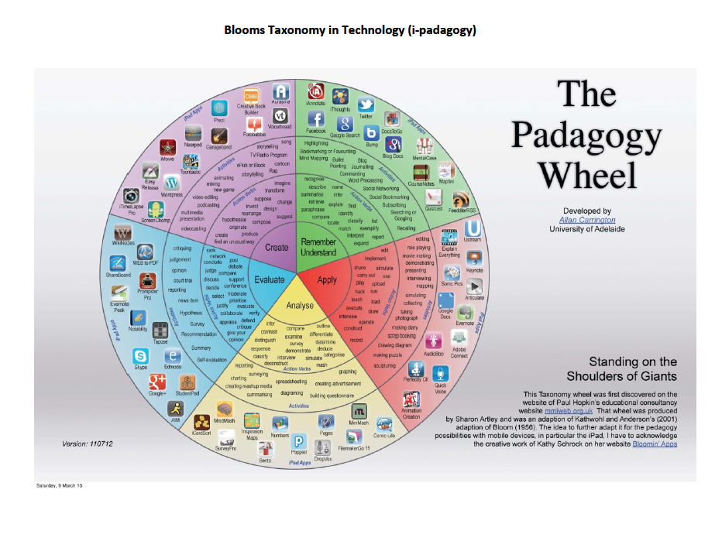
Page 8 in your workbook

Slide 72
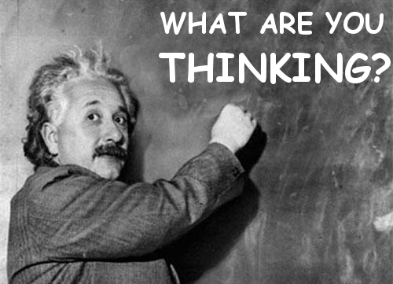
Think point
What are your observations about these learning theories?

Slide 73

They are ALL
Notes:
HANDS ON BRAIN ON PIC

Slide 74
Active Learning within
Career Pathways
Active Learning is anything that students do in a classroom other than merely passively listening to an instructor
http://www.calstatela.edu/dept/chem/chem2/Active/index.htm instructor's lecture.
Notes:
Trainer Notes:
Active Learning in short, anything that students do in a classroom other than merely passively listening to an instructor

Slide 75
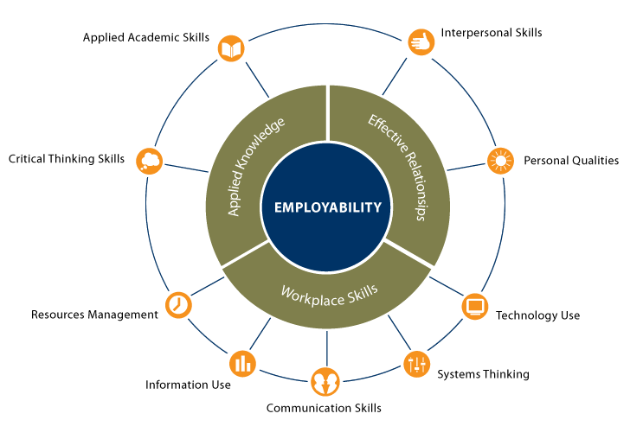
Employability Skills Framework
http://cte.ed.gov/employabilityskills/#
Notes:
Take talking notes from the website:
Also perhaps demo the interactive framework from the site.

Slide 76
What is contextual teaching?
The majority of students are unable to make connections between what they are learning and how that knowledge will be used.
This is because the way they process information and their motivation for learning are not touched by the traditional methods of classroom teaching.
Notes:
Trainer Notes:
Ask the question “How would you define contextual teaching?” Get responses from the participants. On pages 20-21 of the notebook is a paper on contextual teaching and learning. Share the information on the slide.
What is the best way to convey the many concepts that are taught in a particular course so that all students can use and retain that information? How can the individual lessons be understood as interconnected pieces that build upon each other? How can a teacher communicate effectively with students who wonder about the reason for, the meaning of, and the relevance of what they study? How can we open the minds of a diverse student population so they can learn concepts and techniques that will open doors of opportunity for them throughout their lives? These are the challenges teachers face every day, the challenges that a curriculum and an instructional approach based on contextual learning can help them face successfully.
The majority of students in our schools are unable to make connections between what they are learning and how that knowledge will be used. This is because the way they process information and their motivation for learning are not touched by the traditional methods of classroom teaching. The students have a difficult time understanding academic concepts (such as math concepts) as they are commonly taught (that is, using an abstract, lecture method), but they desperately need to understand the concepts as they relate to the workplace and to the larger society in which they will live and work. Traditionally, students have been expected to make these connections on their own, outside the classroom.
However, growing numbers of teachers today (especially those frustrated by repeated lack of student success in demonstrating basic proficiency on standard tests) are discovering that most students' interest and achievement in math, science, and language improve dramatically when they are helped to make connections between new information (knowledge) and experiences they have had, or with other knowledge they have already mastered. Students' involvement in their schoolwork increases significantly when they are taught why they are learning the concepts and how those concepts can be used outside the classroom. And most students learn much more efficiently when they are allowed to work cooperatively with other students in groups or teams.
Contextualized learning is a proven concept that incorporates much of the most recent research in cognitive science. It is also a reaction to the essentially behaviorist theories that have dominated American education for many decades. The contextual approach recognizes that learning is a complex and multifaceted process that goes far beyond drill-oriented, stimulus-and-response methodologies.
According to contextual learning theory, learning occurs only when students (learners) process new information or knowledge in such a way that it makes sense to them in their own frames of reference (their own inner worlds of memory, experience, and response). This approach to learning and teaching assumes that the mind naturally seeks meaning in context, that is, in relation to the person's current environment, and that it does so by searching for relationships that make sense and appear useful.
Building upon this understanding, contextual learning theory focuses on the multiple aspects of any learning environment, whether a classroom, a laboratory, a computer lab, a worksite, or a wheat field. It encourages educators to choose and/or design learning environments that incorporate as many different forms of experience as possible (social, cultural, physical, and psychological) in working toward the desired learning outcomes.
In such an environment, students discover meaningful relationships between abstract ideas and practical applications in the context of the real world; concepts are internalized through the process of discovering, reinforcing, and relating. For example, a physics class studying thermal conductivity might measure how the quality and amount of building insulation material affect the amount of energy required to keep the building heated or cooled. Or a biology or chemistry class might learn basic scientific concepts by studying the spread of HIV or the ways in which farmers maximize water usage for crop production.

Slide 77
What is contextual teaching?
Learning occurs only when learners process new information or knowledge in such a way that it makes sense to them in their own frames of reference
Millenials & post-millenials
Notes:
Trainer Notes:
Ask the question “How would you define contextual teaching?” Get responses from the participants. On pages 20-21 of the notebook is a paper on contextual teaching and learning. Share the information on the slide.
What is the best way to convey the many concepts that are taught in a particular course so that all students can use and retain that information? How can the individual lessons be understood as interconnected pieces that build upon each other? How can a teacher communicate effectively with students who wonder about the reason for, the meaning of, and the relevance of what they study? How can we open the minds of a diverse student population so they can learn concepts and techniques that will open doors of opportunity for them throughout their lives? These are the challenges teachers face every day, the challenges that a curriculum and an instructional approach based on contextual learning can help them face successfully.
The majority of students in our schools are unable to make connections between what they are learning and how that knowledge will be used. This is because the way they process information and their motivation for learning are not touched by the traditional methods of classroom teaching. The students have a difficult time understanding academic concepts (such as math concepts) as they are commonly taught (that is, using an abstract, lecture method), but they desperately need to understand the concepts as they relate to the workplace and to the larger society in which they will live and work. Traditionally, students have been expected to make these connections on their own, outside the classroom.
However, growing numbers of teachers today (especially those frustrated by repeated lack of student success in demonstrating basic proficiency on standard tests) are discovering that most students' interest and achievement in math, science, and language improve dramatically when they are helped to make connections between new information (knowledge) and experiences they have had, or with other knowledge they have already mastered. Students' involvement in their schoolwork increases significantly when they are taught why they are learning the concepts and how those concepts can be used outside the classroom. And most students learn much more efficiently when they are allowed to work cooperatively with other students in groups or teams.
Contextualized learning is a proven concept that incorporates much of the most recent research in cognitive science. It is also a reaction to the essentially behaviorist theories that have dominated American education for many decades. The contextual approach recognizes that learning is a complex and multifaceted process that goes far beyond drill-oriented, stimulus-and-response methodologies.
According to contextual learning theory, learning occurs only when students (learners) process new information or knowledge in such a way that it makes sense to them in their own frames of reference (their own inner worlds of memory, experience, and response). This approach to learning and teaching assumes that the mind naturally seeks meaning in context, that is, in relation to the person's current environment, and that it does so by searching for relationships that make sense and appear useful.
Building upon this understanding, contextual learning theory focuses on the multiple aspects of any learning environment, whether a classroom, a laboratory, a computer lab, a worksite, or a wheat field. It encourages educators to choose and/or design learning environments that incorporate as many different forms of experience as possible (social, cultural, physical, and psychological) in working toward the desired learning outcomes.
In such an environment, students discover meaningful relationships between abstract ideas and practical applications in the context of the real world; concepts are internalized through the process of discovering, reinforcing, and relating. For example, a physics class studying thermal conductivity might measure how the quality and amount of building insulation material affect the amount of energy required to keep the building heated or cooled. Or a biology or chemistry class might learn basic scientific concepts by studying the spread of HIV or the ways in which farmers maximize water usage for crop production.

Slide 78
The contextual approach recognizes that:
Learning is a complex, multi-faceted process.
The mind naturally seeks meaning in context…searching for relationships.
Incorporates different forms of experience.
Internalizing through discovering, reinforcing, and relating.
Notes:
Trainer Notes:
Learning is a complex, multi-faceted process that goes beyond drill-oriented, stimulus-and-response methodologies.
The mind naturally seeks meaning in context, in relation to a person’s environment, doing so by searching for relationships that make sense
and appear useful. Allows students to discover meaningful relationships between abstract ideas and practical applications.
Encourages design of learning environments that incorporate different forms of experience.
Enables concepts to be internalized through discovering, reinforcing, and relating.

Slide 79
The teacher role
Traditional Lecturer
Contextual Facilitator
Information provider
Source of all knowledge and answers
“Sage on the stage”
Coach
Director
Empowers students
“Guide on the side”
Notes:
Trainer Notes:
In addition to making connections between and among various school subjects, educators can enhance the learning process by engaging students in hands-on activities and concrete experiences as other ways of reinforcing the usefulness of the knowledge. Lab activities, experiments, and projects that require students to be actively involved in the community usually stimulate interest and motivation to learn.
Read the slide and provide personal examples if appropriate.
The teacher role
Traditional Lecturer
Information provider
Source of all knowledge and answers
“Sage on the stage”
Contextual Facilitator
Coach
Director
Empowers students
“Guide on the side”

Slide 80
The student role
Traditional
Contextual Active “doer”
Discoverer and user of knowledge
Fits together the pieces of the puzzle
Eager to ask questions that lead to deeper understanding
Generally not motivated to ask questions
Remain seated in desks
Passive recipient of knowledge
Notes:
Trainer Notes:
Read the slide and provide personal examples if appropriate.
The student role
Traditional
Passive recipient of knowledge
Remain seated in desks
Generally not motivated to ask questions
Contextual Active “doer”
Discoverer and user of knowledge
Fits together the pieces of the puzzle
Eager to ask questions that lead to deeper understanding

Slide 81
Classroom methods
Contextual
Traditional
Rote learning
Skill drill
Memorization
“Practice makes perfect”
Multiple-choice tests
Cooperative learning groups
Peer mentoring
Students gather data to solve problems
Alternative assessments
Hands-on, activity-based learning
Notes:
Trainer Notes:
Read the slide and provide personal examples if appropriate.
Classroom methods
Traditional
Rote learning
Skill drill
Memorization
“Practice makes perfect”
Multiple-choice tests
Contextual
Cooperative learning groups
Peer mentoring
Students gather data to solve problems
Alternative assessments
Hands-on, activity-based learning

Slide 82
Four basic premises of contextual learning
Familiar contexts
Experiential
Inter-personal communications, sharing
Transfer of knowledge from one situation to another is not a given
Notes:
Trainer Notes:
Learning is enhanced when new information is presented in familiar contexts.
Most people learn best experientially – meaning through their experiences.
Most people learn best through inter-personal communications, sharing, etc.
Transfer of knowledge from one situation to another is not a given, and is itself a skill to be learned.
The process of what is now called “brain-based learning” or contextual teaching calls for making connections. Psychologists, philosophers, and educators from William James to John Dewey to Jerome Bruner—all the way
to Howard Gardner and Robert Sternberg—have made the case for making connections in education. In the past few decades, neuroscientists have shown the need for making connections in the teaching and learning process.
In 1989, the Secretary of Labor’s Commission on Achieving Necessary Skills (SCANS) was formed under the leadership of Secretary of Labor Elizabeth Dole and Assistant Secretary Robert Jones. Representatives from business, industry, labor, government, and education labored mightily to shed light on the question, “What does work require of schools?” The Commission staff studied the cognitive science research literature related to the importance of contextual teaching. They also interviewed a number of cognitive scientists and more that 500 private and public employers to discover what they expected of educational institutions and what kind of education and
training they thought would be required to meet future needs. As a result the Commission formed the following mission statement:
We believe that these skills (SCANS-recommended skills and competencies) are best learned in context and especially in the context of realistic workplace problems. Thus the teaching of functional skills will require the most radical change in educational practices since the beginning of this century. (SCANS 1991)
The contextual approach to teaching and learning is not a new pedagogical method. There have always been highly effective teachers who motivate their students to achieve academically by connecting content to context. One of the first educational tools for teaching mathematics contextually was called Applied Mathematics, developed in 1986–1988 by a consortium of over 40 state education agencies led by CORD.
The first large-scale test of Applied Mathematics was administered during the 1992–1993 school year, when 326 students completing Applied Mathematics at 20 schools in 13 states were tested in algebra I concepts and compared with 843 traditional algebra I completers. Results showed no significant difference in the scores of the two groups, despite the fact that the Applied Mathematics students had significantly lower entry-level skills. This means that the applied group improved at a higher rate.
During the same school year, four researchers from the University of Georgia studied the Applied Mathematics curriculum as it relates to college preparatory credit. One of their findings dealt with the motivational impact of teaching contextually. Teachers attributed the very high rate of success of students who had not previously been
successful in mathematics, to the positive attitudes students had toward the activity-oriented approach to teaching.

Slide 83
Promising practices in contextual learning…
Problem-Based Learning
Project-Based Learning
Page 13 in notebook
Notes:
Trainer Notes:
There are several classroom teaching strategies that illustrate some or all of the learning theories we’ve covered thus far. You can follow along on page 13 of your notebook or page 236 in the book, and there are internet resources for many of these strategies on page 26 of the notebook.
Problem-Based Learning: With problem-based learning, the educational experience is organized around problems and themes rather than subject-matter disciplines. Problem-based learning is a strategy many teachers use to create a student-centered learning environment in the classroom. Teachers create or encourage students to identify an ill-defined problem or issue that is grounded in the students’ experiences. The classroom teacher then serves as a guide as the students work through solving the problem through a discovery-based, research-rich learning process. When students solve problems rather than learning passively, they take ownership of the knowledge and skills they are gaining. They develop an intrinsic motivation based on the satisfaction of accomplishment.
Project-Based Learning: Project-based learning has become a time-proven approach for providing rigorous, relevant, contextual, learning in a manner consistent with how learning takes place beyond the walls of the school and is also compatible with how the brain learns more efficiently. In project-based learning, individual students, small groups, or the entire class focus on creating a useful product or service or similar tangible outcome that is of authentic value to someone outside the classroom. It is similar to problem-based learning in terms of the constructivist process in which students engage, however, project-based learning goes an important step beyond problem-based learning: creation of a tangible outcome. Ideally, projects should closely resemble the kinds of accomplishments performed by adults in the “real world.”

Slide 84
Promising practices in contextual learning…
Service Learning
Cooperative Learning
Work-Based Learning
Mentorship
Notes:
Trainer Notes:
Service Learning: Many educators believe that young people should be connected with their community and their own humanity through service. The added notion of linking service with learning has made the concept of service even more attractive as a vehicle for better connecting what happens in school with what happens in the real world. Service learning is a form of experiential education and is a powerful vehicle for achieving the goals of character education. Learning is facilitated when it is personally relevant and contextual and when the learners can see application in their own lives of what they are being asked to learn. Service learning usually takes the form of project-based learning with the project being something that serves the good of some element of the community (e.g. working with a non-profit or local government agency).
Cooperative Learning: Cooperative learning involves deliberately structuring working groups to replicate the population in the classroom. The heterogeneous nature of a truly cooperative group may be one of the most significant factors. Students learn from each other, building understanding and tolerance of differences and at the same time learning to value the diversity. The group functions as an interdependent unit to solve a problem, reach a goal, or create a project. The cooperative learning teacher structures activities in such a way as to create a need for students to depend on each other. At the same time, the students are reminded that they have an individual responsibility to contribute to the group outcome. These cooperative methods have been used successfully in industry settings all over the world.
Work-Based Learning: Work-based learning is a critical component of a system capable of preparing students for life. Work-based learning is knowledge, skills, and attitudes taught in the context of work or life settings. This type of student-centered learning goes beyond the classroom by engaging students through direct contact with the workforce. Work-based learning experiences such as internships and apprenticeships place students in realistic work environments, engaging them with real-world problems and empowering them to find real-world solutions.
Mentorship, both workplace-based and off-site, provides adult role models and benefits for students and supervisors. Research shows that mentees improve their job skills, employability skills, academic performance and attendance rates in addition to gaining self-esteem and finding more relevance in their education. Mentors benefit from training future workers and improving their supervisory skills, in addition to the high-quality work they get from mentees. Work-based learning connects the skill or knowledge with the real application.

Slide 85
Promising practices in contextual learning…
School-Based Enterprise
Small Learning Communities
Career Academies
Notes:
Trainer Notes:
School-Based Enterprise: A school-based enterprise is any activity through which students produce goods or services for sale to or use by people other than themselves. It is important to realize that participating in the establishment and operation of a school-related business is preparation for both careers and postsecondary education. Some examples of school-based enterprises are sales of refreshments, school supplies, or other merchandise like furniture or recycled materials. Also, a student-run bank is another example. Students learn creation of a business plan, marketing, accounting, manufacturing, distribution, etc.
Small Learning Communities: The term “smaller learning communities” has been used with schools which have a small population and with small groupings of students and teachers within a larger school. These small groupings have been referred to as an academy, a pod, a building, a team, or a cohort. Students normally stay with an interdisciplinary team of teachers. Several personalized strategies used in the smaller settings have resulted in improved behavior and attendance while students perform as well or better than large school students. The U.S. Department of Education awarded Smaller Learning Communities grants from fiscal year 2000 through 2009 to encourage the development of, and research on, the practice.
Career Academies: A career academy is a type of smaller learning community. The use of career academies is a very promising practice used by a growing number of high schools. However, career academies are more than just a classroom teaching strategy. Career academies are a way to restructure schools. They typically operate as schools within schools with each academy focused on a career theme in which there are good employment opportunities and sufficient businesses in the area that can provide advice to the academy as well as job shadowing and internships to the students. An example of the kind of learning experience typically found in a career academy is project-based learning.
The point of highlighting these promising practices is to find ways to connect CTE and academic knowledge and skills to some real world experience.

Slide 86
Curriculum integration models
CTE courses
Academic courses
Integrated/Hybrid/Blended courses
Linked courses
Clustered courses
  Smaller learning communities
  Career academies
Adapted from: Integrating Academic & Career-Related Education: A Professional Development Guide for Community College Faculty; Teachers College, Columbia University)
Notes:
Trainer Notes:
Curriculum integration models
CTE Courses Infused with High Level Academics
Primary focus is career content – with specific academic skills emphasized
Writing or Mathematics Across-the-Curriculum-Academic Courses Infused with CTE Knowledge/Skills
Teach academic skills using career-related themes
Real-world scenarios/applications are used to reinforce content
Creating PPT presentations in a Speech course
Incorporating Health Sciences concepts in Physics
Hybrid Courses
Courses specifically designed to teach BOTH academic & CTE competencies
ChemCom – Chemistry in the Community
Principles of Technology – Applied Physics
Linked Courses
Paired Courses
Speech & Marketing
Social Studies & Criminal Justice
Align: Curriculum, Assignments, Discussions
Reinforces content/skills learned in each course
Clustered Courses
Referred to as “small learning communities” or “academies” (see below for distinctions)
Groups of students agree to take a cluster of courses
Connect curriculum between one or more academic courses & at least one career-related course
Students usually required to take all of courses offered in cluster
Finance Academy, Criminal Justice Academy
Adapted from: Integrating Academic & Career-Related Education: A Professional Development
Guide for Community College Faculty; Teachers College, Columbia University)
One of the reasons academy students find their learning experiences so rewarding and relevant is that extensive use is made of real-world connected experiences. Two organizations which provide direction and services to career academies are the National Career Academy Coalition (www.ncacinc.com) and the National Academy Foundation (NAF; www.naf.org). NAF reports that more than 97 percent of NAF students graduated from high school—compared to 50 percent of non-academy students in the urban areas where the NAF academies are located.
In a report on career academies funded by several independent foundations, MDRC (a nonprofit, nonpartisan research organization) studied nine urban high schools over a 15-year period. The study followed randomly assigned students from entering high school until eight years after their scheduled graduation. One of the most significant findings is that career academy graduates had 11 percent more sustained earnings than individuals in the control group, and these impacts on earnings are concentrated among young men and students at risk of academic failure.

Slide 87
Advanced ACP Curriculum Integration Models
CTE Courses Infused with High Level Academics
  Primary focus is career content – with specific academic skills emphasized
  Writing or Mathematics Across-the-Curriculum
Academic Courses Infused with CTE Knowledge/Skills
    Teach academic skills using career-related themes
    Real-world scenarios/applications are used to reinforce content
    Creating PPT presentations in a Speech course
    Incorporating Health Sciences concepts in Physics
Hybrid Courses
    Courses specifically designed to teach BOTH academic & CTE competencies
    ChemCom – Chemistry in the Community
    Principles of Technology – Applied Physics
Paired Courses
    Speech & Marketing
    Social Studies & Criminal Justice
    Align: Curriculum, Assignments, Discussions
    Reinforces content/skills learned in each course
Linked Courses
  Paired Courses
    Speech & Marketing
    Social Studies & Criminal Justice
  Align: Curriculum, Assignments, Discussions
  Reinforces content/skills learned in each course
Clustered Courses
  Referred to as “small learning communities” or “academies” (see below for distinctions)
  Groups of students agree to take a cluster of courses
  Connect curriculum between one or more academic courses & at least one career-related course
  Students usually required to take all of courses offered in cluster
  Finance Academy, Criminal Justice Academy
Adapted from: Integrating Academic & Career-Related Education: A Professional Development
Guide for Community College Faculty; Teachers College, Columbia University)

Slide 88
CONTEXTUAL TEACHING PRACTICES
Notes:
Switching gears:
Now that participants have been introduced to Career Pathways as an organizing principle for developing adult education curriculum and also to the resources available to them through LINCS, it is time to explore contextual teaching and learning. This will be an introduction for some and a review for others. Later in the workshop, participants will be guided to identify workplace and career pathways contexts in existing ACP resources.

Slide 89
Learning Objectives
Based on what they have learned about contextualized instruction, participants will be able to identify the:
Characteristics of contextual instruction,
Instructor roles in a contextual classroom,
Learner roles in a contextual classroom, and
Classroom methods associated with contextualized instruction.

Slide 90
Contextual learning reminders
Multiple Styles
Remember multiple intelligences and multiple learning style preferences
Hands-On
Scaffolding
Menu
Combine hands-on and minds-on activities
Create mental scaffolding that helps concepts stick
Allow students to select from a menu of options for gathering, organizing or expressing new knowledge
Notes:
Trainer Notes:
Convey Information Using Multiple Modes --this is a reminder that students learn in various ways, so multiple modes of interaction with the content should be planned
Remember multiple intelligences and multiple learning style preferences
Combine hands-on and minds-on activities
Create mental scaffolding that helps concepts stick
Allow students to select from a menu of options for gathering, organizing or expressing new knowledge

Slide 91
The Contextual Approach Supports Best Practices for Reaching Adult Learners
Encourages design of learning environments that use multiple teaching modalities and incorporate different forms of learning experiences.
Allows learners to discover meaningful relationships between abstract ideas and real-world applications.
Enables concepts to be internalized through discovery, reinforcement/modeling, and problem-solving.
Provides ongoing feedback that promotes further learner interaction with content.
Engages learners and motivates them to persist.
Notes:
Facilitator prerequisites:
Familiarity with
National Research Council. (2012). Improving Adult Literacy Instruction: Options for Practice and Research. Committee on Learning Sciences: Foundations and Applications to Adolescent and Adult Literacy, A.M. Lesgold and M. Welch-Ross, Eds. Division of Behavioral and Social Sciences and Education. Washington, DC: The National Academies Press.
http://www.nap.edu/catalog.php?record_id=13242
Chapter 4, p.110-111
Talking points:
This slide provides a research-based overview of how contextualized instruction supports the principles of good instructional design for reaching adult learners. The slides that follow ask participants to envision what this looks like when applied in the classroom.

Slide 92
The CTL Classroom Environment:
The Instructor Role
Facilitator
Coach
Director
Empowers learners
“Guide on the side”
Notes:
Talking points:
While participants may not have been familiar with contextualized instruction before the workshop, they have probably been practicing many components of it already. They have enough background information from the previous workshop content to think critically and draw conclusions about appropriate Instructor, Roles, Learner Roles, and Classroom methods in contextualized instruction.
Activity: Ask participants to brainstorm what the role of instructor in the contextual classroom looks like. (Again, many of them practice elements of contextualized instruction already.) This activity could be done with a flip chart—one trainer with the slides and another writing participants’ responses. Some suggested answers can then be revealed on mouse click.
You may want to review the content on the previous slide and guide participants to respond with roles that support these items:
The Contextual Approach--
Encourages design of learning environments that use multiple teaching modalities and incorporate different forms of learning experiences.
Allows learners to discover meaningful relationships between abstract ideas and real-world applications.
Enables concepts to be internalized through discovery, reinforcement/modeling, and problem-solving.
Provides ongoing feedback that promotes further learner interaction with content.
Engages learners and motivates them to persist.

Slide 93
The CTL Classroom Environment:
The Learner Role
Active “doer”
Discoverer and user of knowledge
Fits together the pieces of the puzzle
Eager to ask questions that lead to deeper understanding
Notes:
Talking points:
In this activity participants will identify what they see as the primary Learner Roles in the contextual classroom.
Activity: Ask participants to brainstorm what the role of learner in the contextual classroom looks like. This could be done with a flip chart—one trainer with the slides and another writing participants’ responses. Some suggested answers can then be revealed on mouse click.
Possible responses from participants include: learners participate actively; learners take responsibility for exploration of content; learners formulate questions; learners solve problems; learners work collaboratively.

Slide 94
The CTL Classroom Environment:
Teaching Methods
Cooperative learning groups
Peer mentoring
Gather data to solve problems
Formative assessments
Hands-on, activity-based learning
Notes:
Facilitator prerequisites:
Familiarity with Bloom’s Taxonomy of Educational Objectives and the updated version of it.
A helpful article:
Abudi, G. (2010). “Using Bloom’s Taxonomy: Teaching Adults to Learn Effectively.”
http://www.ginaabudi.com/using-blooms-taxonomy-teaching-adults-to-learn-effectively/
Talking points:
In this activity participants will identify Classroom Methods appropriate for use in the contextual classroom.
Activity: Ask participants to brainstorm what classroom methods that would support contextual instruction. This could be done with a flip chart—one trainer with the slides and another writing participants’ responses. Some suggested answers can then be revealed on mouse click.
Vocabulary: Participants may need to prompted to describe formative assessments for their colleagues. Ask for a volunteer to give examples; guide if necessary.
Potential answers include: there are more activities in the contextual classroom; learner engagement is encouraged; assessments could be more “real-world”; ongoing feedback is provided to encourage learner understanding and continuing interaction with content
Use the topic of learner engagement as the transition topic for the next slide.

Slide 95
Stop and Share
Describe an episode in which you were engaged in contextual learning—either in or out of the classroom.
Share your reflections on the experience.
Did the information or skills you learned through contextual strategies "stick" with you better than if you had sat through a lecture? Why or why not?
Did the contextual learning experience make learning easier or more difficult for you? Explain.
Notes:
Handout #5: Stop and Share--Reflection on Contextual Learning Experiences
Facilitator prerequisites:
Familiarity with
National Research Council. (2012). Improving Adult Literacy Instruction: Options for Practice and Research. Committee on Learning Sciences: Foundations and Applications to Adolescent and Adult Literacy, A.M. Lesgold and M. Welch-Ross, Eds. Division of Behavioral and Social Sciences and Education. Washington, DC: The National Academies Press.
http://www.nap.edu/catalog.php?record_id=13242
Chapter 4, p.110-111
Talking points:
In this activity, participants will reflect on personal experiences with contextual learning—in the classroom (e.g. learning to measure using rulers to calculate height in health class)—or out of the classroom (e.g. learning to measure using measuring cups in the kitchen).
Questions 1 & 2 should elicit positive responses for contextual learning, with reasoning aligned to the Contextual Approach Supports Best Practices for Reaching Adult Learners and/or REACT strategies slides. Recall the principles of adult learning referenced at the beginning of this topic:
Encourages design of learning environments that use multiple teaching modalities and incorporate different forms of learning experiences.
Allows learners to discover meaningful relationships between abstract ideas and real-world applications.
Enables concepts to be internalized through discovery, reinforcement/modeling, and problem-solving.
Provides ongoing feedback that promotes further learner interaction with content.
Engages learners and motivates them to persist.
This activity can be done collaboratively at tables or individually. Either way, participant reflections on the discussion prompt illustrating their personal experiences (context in which this material is being learned) should be shared with the whole group.

Slide 96
Before we move on..
What questions do you have about contextual teaching and learning?
Notes:
Talking points:
Before proceeding, ask whether there are any questions about the content thus far.

Slide 97
Contextual learning reminders – Pg. 9 review
Design activities that require students to take more responsibility for their learning
Explain performance expectations very clearly and before the project starts
Provide resources and direction, but not easy answers
Encourage independence to build skills for life-long learning
Notes:
Trainer Notes:
Going back to page 9 in our notebooks, our goal is to facilitate learning, because good teaching as a guide on the side encourages students to take greater responsibility for their learning and supports life-long learning skills
Design activities that require students to take more responsibility for their learning
Explain performance expectations very clearly, have a rubric already established and disseminated to students prior to the project starting, so they know what is excellent work verses work that could use improvement.
Provide resources and direction, through guided questions. Do not provide students with easy answers; encourage independence to build skills for life-long learning

Slide 98
Authentic assessments
Display of working model
Completion and explanation of multi-step process
Presentation/
poster session
Technical skills demonstration
Website, video, or portfolio
Written report or other product
Case study analysis, discussion and debate
Give frequent, ungraded feedback to guide student development and re-direct efforts
Require demonstration of skills/learning
Notes:
Trainer Notes:
Use Authentic Assessments--designing assessments that go beyond tests—using real-world tasks
Read the slides
Give frequent, ungraded feedback to guide student development and re-direct efforts
Require demonstration of skills/learning, e.g.,
Display of working model
Completion and explanation of multi-step process
Class presentation/poster session
Technical skills demonstration
Website, video, or portfolio
Written report or other product
Case study analysis, discussion and debate

Slide 99

LUNCH!!!!!!!

Slide 100

Teaching & Technology Tools
Notes:
Trainer Notes:
Delivery methods for education and worker training must also continue to expand, particularly in ways that more efficiently help to retrain displaced or under-skilled adult workers. Online learning, a rapidly growing methodology, is one way this is likely to occur.
Online learning enables students to connect with course materials they might not otherwise be able to access, at times and in ways that are more convenient to them, which is of particular importance to working adults and students in rural areas. The number of elementary and secondary students taking online courses increased tenfold between 2000 and 2007, as documented by the Sloan Consortium21, and a study from the National Research Center for CTE finds that almost half of community colleges offer credit-granting online occupational programs in which at least 50 percent of course content is delivered online.
Online learning isn’t just convenient and flexible. It works. Research from the Center for American Progress concludes that online learning provides high-quality instruction, while the Department of Education has found that students who take courses online perform slightly better than those who receive face-to-face instruction.
Within CTE, some course content such as web design can be delivered entirely online. Other CTE programs require a hybrid approach that includes work-based learning activities such as internships and, in some cases, on-campus skill acquisition through laboratory courses. Whether content is delivered entirely online or in a hybrid format, online learning has proven itself an effective strategy for CTE and workforce training in schools such as Auburn Career Center (OH).
In addition, mastering the use of digital technology is an important part of career readiness for almost any workplace. When technology is embedded into classrooms, students are not just engaged. They also learn how to effectively use digital tools on a daily basis, as they often will in the workforce, and how to participate in our world as digital citizens.

Slide 101
On-line Learning
Games
Simulations
Edmodo
Socrative
Wordle & Tagxedo
Blabberize
Glogster & Eduglogster
Toondoo, Toontastic, Toon Camera
Second Life
Scratch
Scribble Press
Madpad
QR Code Readers/
Creators
Weebly
Symbaloo
History Pin
Twitter & Twiducate
World Of Warcraft
Scavenger Hunt
Wiggio
Remind 101
Woices
Notes:
Trainer Notes:
Games, simulations and technology can help any educator motivate and engage learners. Here are some examples and they are found on page 23 in your notebook.
ACTIVITY: Show us one that you use or explore one and give a synopsis. Give an example of how you would integrate it.
Edmodo – allows you to ask questions, share information/experiences/ideas, collaborate, comment on the material/presenter/posts, increases communication between teachers, students, and/or between students and the teacher.
Socrative – allows assessments, polls, and communication
Woices – hear native languages, historical tours, cultural differences, etc.
Wordle & tagxedo – create art with words
Blabberize – put dialog with any picture
Glogster & eduglogster – create interactive posters
Toondoo, toontastic, toon camera – help create cartoons
Second Life – an interactive virtual world
Scratch – anyone can easily create a simple game
Scribble Press – create and share stories by turning them into online books
MadPad – Remix sounds to create music
QR code readers & creators – use codes for quick links, audio or video files, pictures or diagrams
History Pin – combines photography of locations from past and current pictures
Twitter & Twiducate – can be used for communicating between teachers, students, and students & teachers
World of Warcraft – a popular game that has its own economics, politics, and critical thinking/problem-solving within groups
Scavenger Hunt – create your own campus-wide or off-campus scavenger hunt
Weebly – easily create your website
Symbaloo – easily create your own social bookmarking website
Remind 101 – keep in touch with students (and/or parents) using a one-way texting and/or email system without giving up privacy of sharing personal phone numbers and email addresses

Slide 102
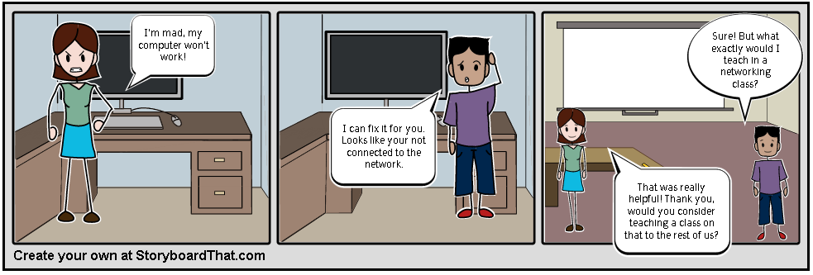
Media as emotional hook
Story boarding
Video
Notes:
Trainer Notes:
If you have the time, patience and resources, consider extending the lesson using multimedia. According to Dr. Judy Willis, author of Research Based Strategies to Ignite student Learning, today’s students have larger ocular sections of their brain than previous generations. Using a fMRI (a functional MRI) scientists can see that young people gather more information using their eyes than other generations.
Using a video, similar to a movie trailer to emotionally engage students in their learning, is what we call emotional hook. You will want to story board your scenario so you can organize it in a logical sequence. Afterward, you can use a variety of multimedia tools to create a video of your story board; such as i-movie, movie maker, power point (as in this example), Prezi, and others.
Click on example (expand if need be) 3 minutes long. Notice that the video is pretty raw and not professionally edited, most students today like more “real” footage – those get the most hits on You Tube!
Note, the story board and the video are not the same example.
If you are not comfortable designing your own video, encourage your students to use this format to document their learning.

Slide 103
Table Talk
How are you using interactive technology
in your classroom?

Slide 104

The flipped classroom uses technology
to allow students more time
to apply knowledge and
teachers more time
for hands-on education.
It’s a continually changing strategy that evolves with technology.

Slide 105
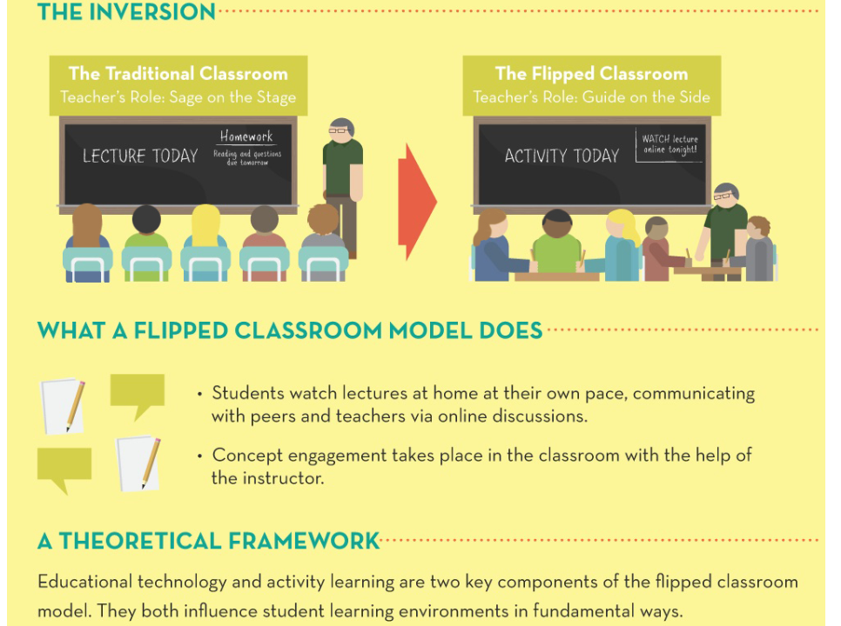

Slide 106
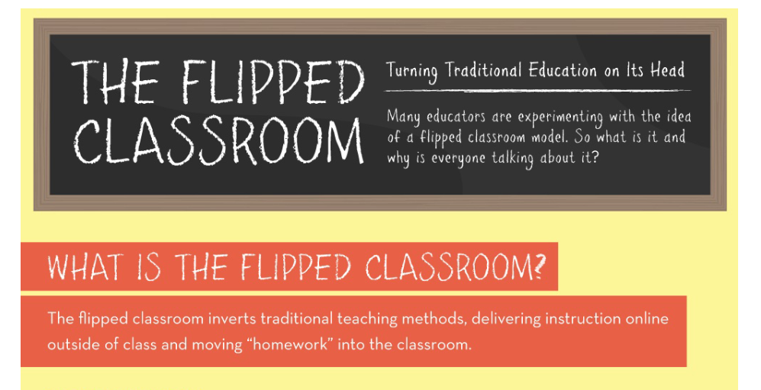

Slide 107
Career Pathways Goals
Career Pathways services should have among their goals:
Focus on secondary and postsecondary industry- recognized credentials;
Sector specific employment; and,
Advancement over time in education and employment within a sector.

Slide 108
What does an ACP look like?

Slide 109
















16 Career Clusters = Broad Industry Sectors
http://www.careertech.org/career-clusters/glance/careerclusters.html
Notes:
Talking points:
These are designed to represent the entire world of work. Some states have added specific clusters where they saw a need, such as the Energy cluster in Florida.

Slide 110
ACTIVITY: Clusters In The News
http://www.careertech.org/career-clusters/glance/careerclusters.html
Notes:
Talking points:
These are designed to represent the entire world of work. Some states have added specific clusters where they saw a need, such as the Energy cluster in Florida.

Slide 111
Career clusters model
16 broad clusters; each has knowledge and skill statements.
Each cluster encompasses career pathways.
Pathways lead to many occupations.

Slide 112
Career Pathways Components
Alignment with secondary and postsecondary education with workforce development systems and human services
Connection of basic education and skills training through “bridge” curriculum and integrated education and training
Programs with multiple entry and exit points that accommodate work schedules with flexible and non-semester-based scheduling, and the innovative use of technology

Slide 113
Career Pathways Components
Alignment with the skill needs of targeted industry sectors important to local, regional, or state economies
Using curriculum and instructional strategies appropriate for adults that make work a central context
Accelerating participant educational and career advancement through credit for prior learning and other strategies
Including comprehensive support services, including career counseling, child care, and transportation

Slide 114
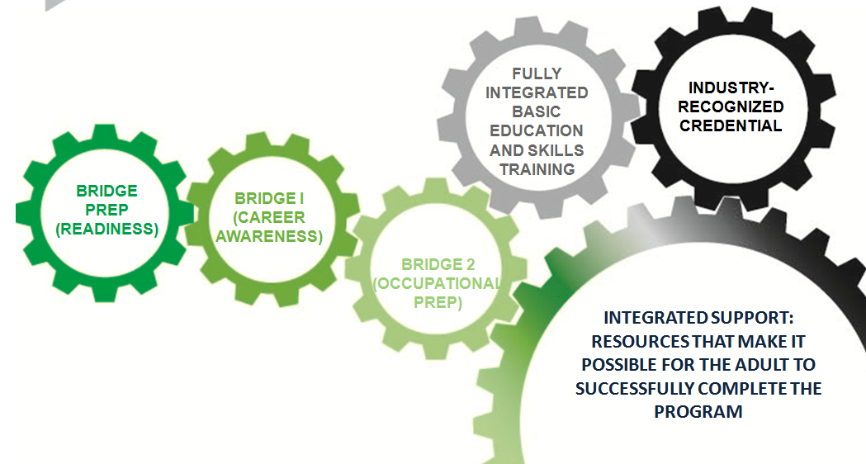
How does ABE/ASE/ESL content fit with career pathways?
Minnesota FastTRAC Career Pathways Model
Notes:
Facilitator prerequisite:
Be familiar with the Minnesota FastTRAC model http://mnfasttrac.org/, which consists of a series of bridge preparation and bridge courses that lead to entrance into a postsecondary program. The career pathway also prepares learners for an entry-level job with opportunities for advancement upon completion of successive course levels.
Talking points:
It is important that participants understand where ABE/GED/ESL coursework fits within the continuum of career pathway coursework. Career pathways can work in managed and open enrollment program environments as well as small or larger class sizes.

Slide 115
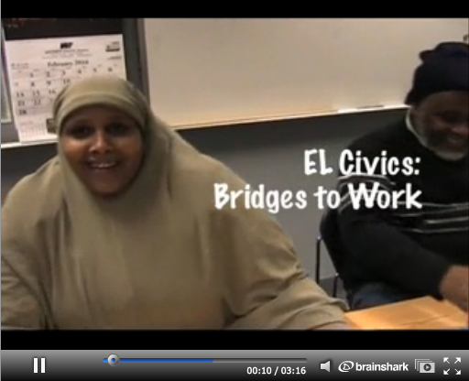
Minnesota sample lesson
Provides a bridge from literacy-level ELL to entry-level work and occupational preparation courses
Curriculum and materials integrate work skills into life skills themes and focus on authentic work and language skills practice
http://my.brainshark.com/EL-Civics-142661177
Notes:
Facilitator prerequisite:
Minnesota FastTRAC Adult Career Pathways. (2011). Minnesota FastTRAC adult career pathway program model [PowerPoint slides]. Retrieved from
http://www.mnfasttrac.org/docs/MN%20FastTRAC%20Program%20Model%20Je%202011.ppt
Activity: Watch the Minnesota sample lesson, EL Civics: Bridges to Work, and have participants reflect on the video.
This example lesson is from Bridge Prep (first level) of the MN FastTRAC model. Bridge Prep courses feature:
Intentional focus on work content by embedding work skills in ABE/ESL coursework.
Demonstrated learning through simulations and practice of work skills.
Intentional focus on cultural/soft skills needed to be successful in a career path.
Exposure to authentic work sites.
Link to video – EL Civics: Bridges to Work: http://my.brainshark.com/EL-Civics-142661177
Watch the video with participants. Afterwards, reflect on the video with participants.

Slide 116
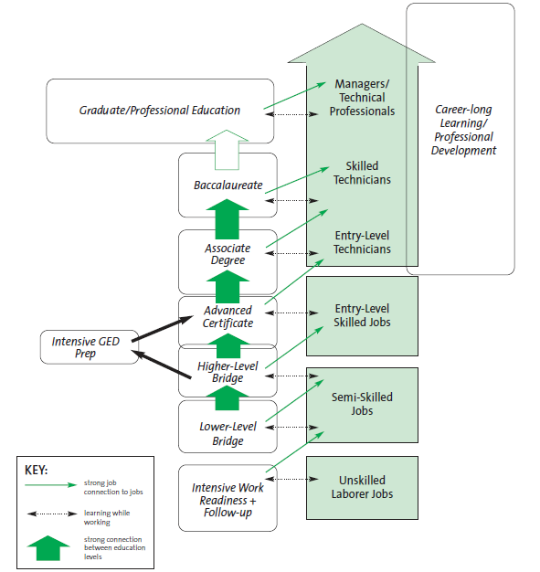
ABE/ESL/GED in Career Pathways
Educational Pathway to Careers for Adults
Bridges to Careers for Low-Skilled Adults, Women Employed
Notes:
Facilitator prerequisite:
Women Employed with Chicago Jobs Council and UIC Great Cities Institute. (2005). Bridges to careers for low-skilled adults: A program development guide. Retrieved from http://www.womenemployed.org/sites/default/files/resources/BridgeGuide.FullReport.2005.pdf
Talking points:
This model shows the correlation between educational advancement and job advancement.

Slide 117
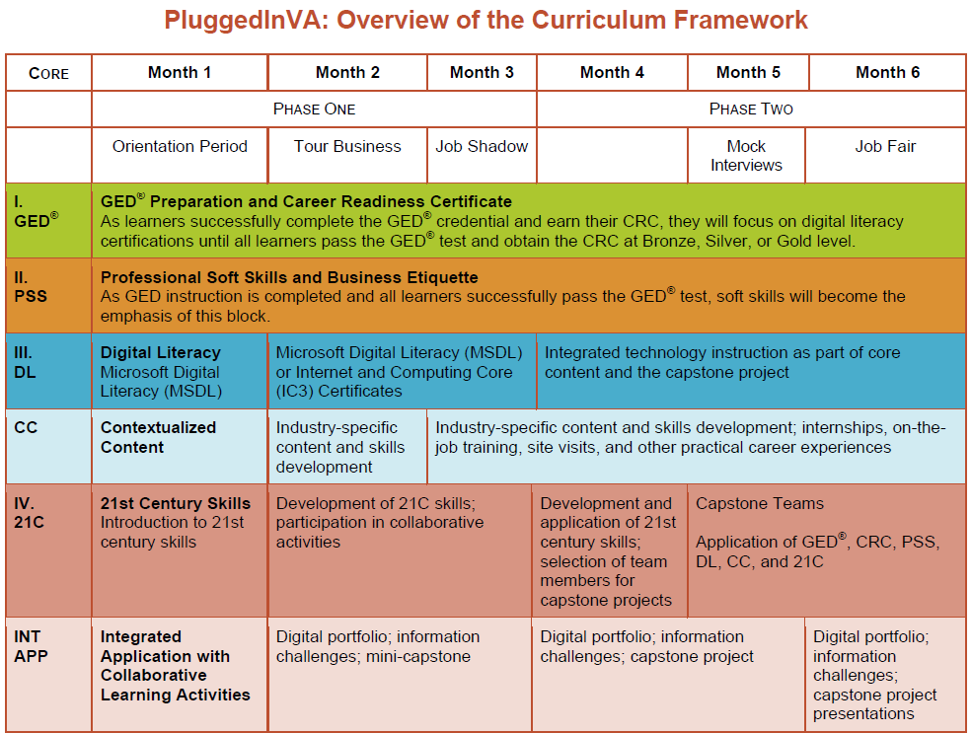

Slide 118
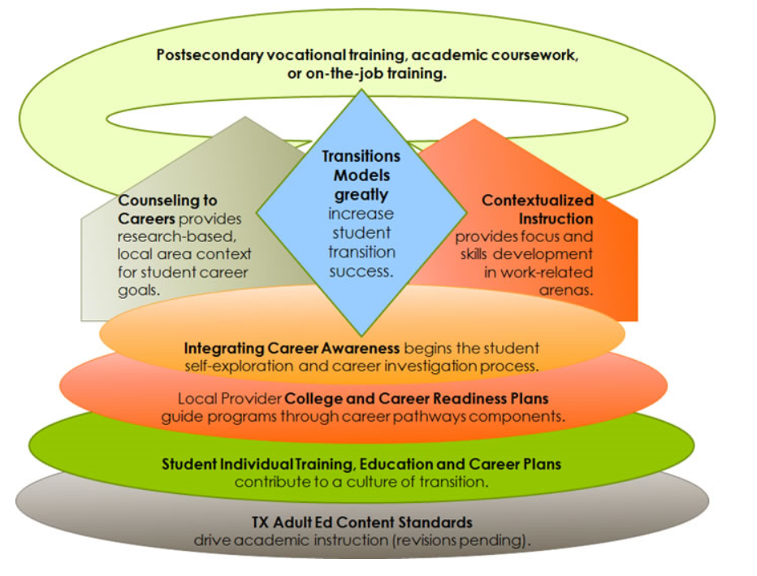
Notes:
Texas model program, from the TCALL site

Slide 119
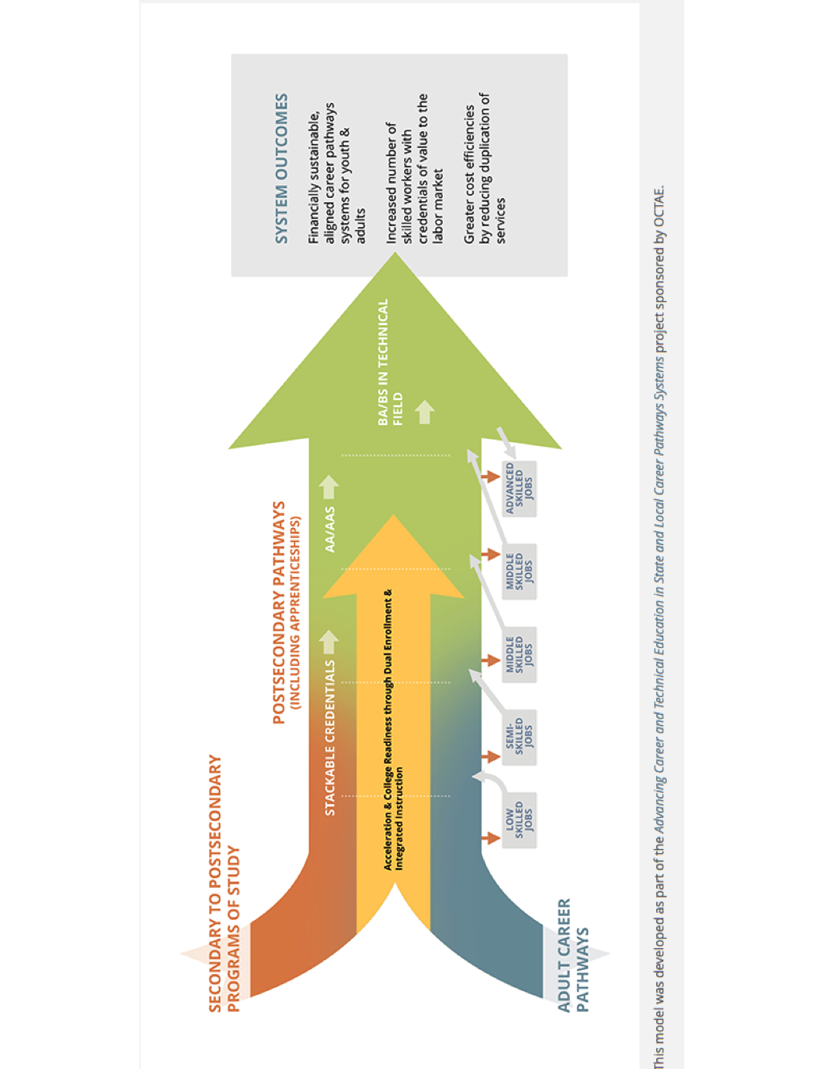

Slide 120
Before we move on…
Career pathways lead to higher levels of future education and employment.
  TRUE
Career pathways are implemented the same way in every region.
  FALSE
Career pathways consist of a series of connected education and training strategies and support services.
  TRUE
Career pathways address employer needs.
  TRUE
Notes:
Talking points:
This formative assessment addresses the learning objectives of the session just completed.
Answers are animated to fly in on mouse click.

Slide 121
CHARACTERISTICS OF CONTEXTUAL CURRICULA: WHAT ARE WE LOOKING FOR?
Notes:
Switching gears:
From the preceding section, participants have gained an understanding of and simple experience with contextualized instruction. They have also reflected on their own experiences learning in context.
In this section, you will facilitate the “unpacking”— examination of 4 key elements of career pathways curriculum housed in the LINCS online resource collection.
Workplace context
Relevance to career pathways
Basic academic skills, technical skills, and employability skills addressed
Student engagement strategies
Talking points: The rationale for this process is threefold. It models the process the small groups will use to unpack curriculum in section 3 of this workshop; illustrates several different ways in which these elements might be addressed; and prepares participants to use these elements as the foundation for developing their own Adult Career Pathways instructional materials.

Slide 122
Session 4: Learning Objectives
Participants will be able to identify characteristics of contextual curriculum:
Workplace context
Relevance to career pathways
Three types of foundational skills addressed: basic education, technical skills, employability skills
Learner engagement strategies

Slide 123
Characteristics to Examine in Existing Lessons— “Unpacking”
Workplace context
Relevance to career pathways
Three types of foundational skills addressed: basic education, technical skills, employability skills
Learner engagement strategies
Notes:
Talking points:
These are the characteristics we will use to unpack (examine elements closely) ABE/ESL/GED curriculum in career pathways. First we will examine each of these characteristics in detail and then we will use them to unpack several examples from the LINCS Resource Center.

Slide 124
Characteristic 1: Workplace Context
  Instructional materials teach basic reading, writing, speaking, and mathematics concepts and skills in contexts applicable to an industrial or occupational setting.
  Learners participate in authentic workplace situations.
  .
Notes:
Facilitator prerequisites:
Familiarity with the instructional resources contained in the LINCS Resource Center, with particular attention to the ways in which instruction is organized (structure).
Talking points:
Recall two descriptions of contextualized instruction—
(1) Contextualization relates instructional content to the specific contexts of learners’ lives and interests to increase retention of information and motivation to learn.
(2) Contextualization integrates basic reading, math, and language skills and industry/occupation knowledge.

Slide 125
Facilitation of learning in context may be structured in many different ways, for example:
In a workplace context, reading, writing, listening, speaking, and mathematics can…
be taught by ABE instructors using a real-world scenario to provide career pathways context.
be addressed in the technical or workforce course by a technical instructor or an ABE co-instructor.
Notes:
Talking points:
There are many different models for instructional design that address both ABE and technical concepts. ABE concepts (reading, writing, listening, speaking, mathematics) can be contextualized in several ways. For example, some curricula integrate technical skills and basic education and some offer side-by-side tutoring.

Slide 126
Characteristic 2: Relevance to Career Pathways
How do these instructional materials move the adult learner closer to the transition goal of:
  Employment in a target industry?
  Enrollment in an industry-specific postsecondary program? (Generally a career and technical program)
Career clusters model
  16 broad clusters; each has knowledge and skill statements.
  Each cluster encompasses career pathways.
  Pathways lead to many occupations.
Notes:
Facilitator prerequisites:
Familiarity with the National Career Clusters Initiative, http://careertech.org.
Talking points:
The second characteristic we’ll unpack is the relevance of the instructional materials to career pathways. Remember that a career pathway is--
“A series of connected education and training strategies that enable individuals to secure employment within a specific occupational sector and to advance over time to successively higher levels of education and employment in that sector. Each step on a pathway is designed to prepare the participant for the next level of education and employment.”
So, in unpacking this characteristic, we’re looking for learner advancement within their selected pathway. As we unpack curriculum, we should ask these questions:
Is the lesson designed to help learners master content required for entry to an educational program leading to a career?
Does the lesson or curriculum provide instruction relevant to a specific career or a broad cluster of careers?
The next slide illustrates the sixteen career clusters and can be used as a reference by participants as they unpack resources.

Slide 127
16 Career Clusters
http://www.careertech.org/career-clusters/glance/careerclusters.html
Notes:
Talking points:
These are designed to represent the entire world of work. Some states have added specific clusters where they saw a need, such as the Energy cluster in Florida.
The third characteristic we’ll be unpacking involves three fundamental skills addressed by the instructional materials.

Slide 128
Do You Know…?
What are several types of skills or competencies that apply to Adult Career Pathways instruction?
  Basic skills—reading, writing, speaking, mathematics
  Technical skills for a career
  Employability skills for getting and keeping a job
Notes:
Talking points:
This is a pre-assessment of knowledge before introducing standards—one of the unpacking elements.
Activity: Ask participants “What are several types of standards that apply to Adult Career Pathways instruction?”
Use flip chart to write participants’ answers.
Answers may vary widely, as terminology differs. Some possible answers include:
content standards, academic standards, industry standards, CASAs standards, GED standards; soft skills standards; employability skills standards; College and Career Readiness standards; 21st-century standards; national work readiness credential; state standards; Common Core, etc.
As you write, be sure to ask the speaker what those standards look like in practice at their institution, in their region, or in their state. The slides that follow divide standards into 3 broad categories—foundational content standards, industry standards, and soft skills.

Slide 129
Characteristic 3: Three Fundamental Skill Sets
#1– Basic Skills Content
What are the foundational basic skills content areas?
  Reading, Writing, Listening and Speaking, and Mathematics
Where can you find information about the foundational basic skills to be taught in your adult education program?
  Texas College and Career Ready Standards
  Your program administrator or instructional lead
  College and Career Readiness Standards for Adult Education (U.S. ED)
Notes:
Facilitator prerequisites:
Talking points:
There are three broad categories of skills addressed in the example curricular materials—foundational basic adult education skills (academic), industry and technical standards, and soft skills or employability standards.
Note: Foundational basic skills may be called content standards or “College and Career Readiness” standards in some states and soft skills standards may be referred to as Employability skills (2012) SCANS skills (1991) or 21st Century skills (2012) .

Slide 130
Characteristic 3: Three Fundamental Skill Sets
#2: Industry-Specific Technical Skills
Industry-Specific Technical Skills are required for certification on the required expertise levels determined by a certifying association or organization.
Where can you locate more information about the technical skills required?
  Professional organizations or trade associations, e.g., National Association of Manufacturers, National Restaurant Association, National Automotive Technicians Education Foundation
  Local employers
  Colleagues from technical programs
  Local workforce or economic development board
Notes:
Talking points:
Ask participants about career pathways programs at their institutions or in their region. Discuss the value of collaborative curriculum planning. (Collaborative planning with colleagues in technical fields and local employers helps instructional designers identify multiple standards that can be addressed within the same course.)
There are two ACP-SC online courses on LINCS that will help them start building collaborative relationships:
“Building Strategic Partnerships” and “Engaging Employers to Support Adult Career Pathways Programs.”

Slide 131
Characteristic 3: Three Fundamental Skill Sets
#3: Employability skills
General skills required to be successful at all levels of employment and in all sectors
Sometimes referred to as 21st Century skills, soft skills, and SCANS skills
Job-getting and job-keeping skills
Notes:
Facilitator prerequisites:
Familiarity with the descriptions of employability skills from the U.S. Dept of Education Employability Skills Framework http://cte.ed.gov/employabilityskills/#
What are Employability Skills?
Employability skills are general skills that are necessary for success in the labor market at all employment levels and in all sectors. These skills, which may be taught through the education and workforce development systems, fall into three broad categories:
Applied Knowledge—the thoughtful integration of academic knowledge and technical skills, put to practical use in the workplace.
Effective Relationships—the interpersonal skills and personal qualities that enable individuals to interact effectively with clients, coworkers, and supervisors.
Workplace Skills—the analytical and organizational skills and understandings that employees need to successfully perform work tasks.
In tandem with academic and technical skills, employability skills are critical to college and career readiness.
Talking points:
From the Employability skills website: employability skills are defined as general skills required for success in the labor market at all employment levels and for all sectors.
Ask participants to list soft skills valued by employers.
Potential responses include: teamwork; honesty; professionalism; problem-solving; interpersonal communication; conflict resolution; etc.

Slide 132
Employability Skills Framework
http://cte.ed.gov/employabilityskills/#
Notes:
Take talking notes from the website:
Also perhaps demo the interactive framework from the site.

Slide 133
Page 8 IN YOUR WORKBOOK

Slide 134
Characteristic 4: Learner Engagement Strategies
Strategies for learner engagement:
Relating
Experiencing
Applying
Cooperating
Transferring
These are not necessarily used in a linear sequence. Not all REACT strategies may be present in a single lesson.
Notes:
Talking points:
Recall the REACT mnemonic discussed earlier. (Participants have the handout already.) These strategies support contextualized instruction and serve as signs that active learning is taking place.
Now review the characteristics we’ll be looking for as we unpack three lessons from the ACP-SC Resource Center:
1. Workplace context
2. Relevance to career pathways
3. Three types of foundational skills: basic education, technical skills, employability skills
4. Learner engagement strategies

Slide 135
Before we move on…
Which characteristic that we’ll be unpacking-
Teaches basic reading, writing, speaking, and mathematics concepts and skills applicable to an industrial/occupational setting?
  Workplace context
Provides instruction that moves the adult learner closer to the transition goal of employment in a target industry?
  Career pathways
The categories of skills and competencies we look for in a lesson?
  Basic skills, technical skills, employability skills
Can be remembered using the mnemonic REACT?
  Learner engagement strategies
Notes:
Talking points:
Formative assessment
Now review the characteristics we’ll be looking for as we unpack three lessons from the ACP-SC Resource Center:
1. Workplace context
2. Relevance to career pathways
3. Three types of foundational skills: basic education, technical skills, employability skills
4. Learner engagement strategies
Answers will fly in with a mouse click.

Slide 136

UNPACKING THREE LESSONS TO FIND THE KEY CHARACTERISTICS
The following lesson excerpts are taken from complete instructional materials available at:
https://lincs.ed.gov/professional-development/resource-collections
Notes:
Handout #6: Template (table) for use unpacking 3 examples with entire group.
Talking points:
Now we’ll apply what we just learned to the process of unpacking three example lessons. These lessons, and over 100 more, are available at the project’s website. We encourage you to explore the collection when you’re building or enhancing Adult Career Pathways courses.

Slide 137
Session 5: Learning Objectives
Participants will “unpack” three different instructional resources by identifying their:
  Workplace context
  Career pathways
  Three fundamental skill and competency types
  Learning engagement strategies

Slide 138

Literacy Information and Communication System
LINCS provides high-quality, on-demand learning opportunities to practitioners of adult education, so they can design and deliver education programs that help adult learners successfully transition to postsecondary education and 21st century jobs.
https://lincs.ed.gov/
LINCS is funded by the U.S. Department of Education, Office of Vocational and Adult Education. It is managed by Kratos Learning, with technical development by Quotient, Inc.

Slide 139
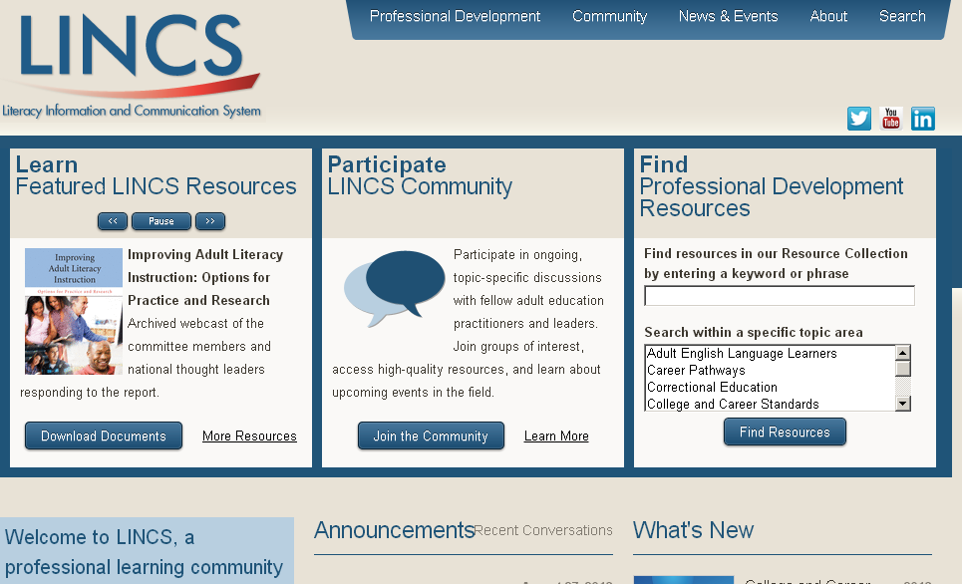
Literacy Information and Communication System

Slide 140


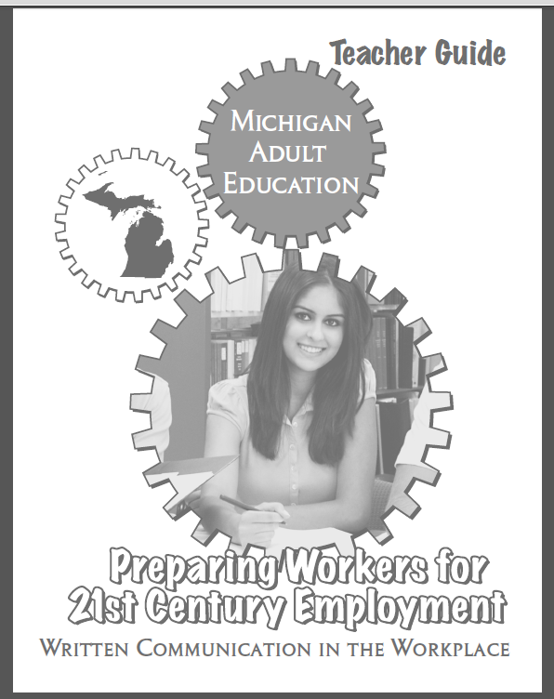
Notes:
Handout #4 Template for Unpacking 3 resources
Handouts #5, 6, 7: The lessons for unpacking
Talking points:
We have selected example lessons in mathematics, ESL, and writing from the LINCS instructional resource collection to practice unpacking together. Each resource is structured differently but they share common characteristics.
This is a guided activity in which the facilitator provides clues, reminders, reviews of previous content and additional background information to assist the group as they unpack example lessons.
Each participant should have a copy of the unpacking handout that presents the characteristics in table format. The procedure will be to examine the lesson together, take a minute or two for reflection and completion of the appropriate column in the table, and then return to the PowerPoint to discuss and reveal answers with the whole group. Facilitator should pay attention to “wait time”--ensuring that s/he does not act as the expert and gives participants time to answer.

Slide 141
Resource 1:
Washington ABE Contextual Math
Written by instructors for the Washington State Board for Community and Technical Colleges
PowerPoint files (with some audio) containing self-paced lessons integrating occupational content and mathematics
The excerpts that follow are from the Commercial Trucking lesson series.
Notes:
Handout #5: Washington ABE Math Excerpt
Unique format—PowerPoint presentation with audio integrated; interactive practice sections with feedback; can be used individually (at home or computer lab) or with a tutor; could be integrated into an online course

Slide 142
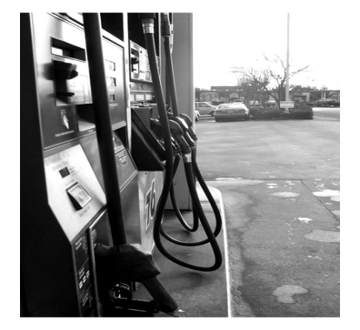
Washington ABE Math Excerpt: Gas Prices and Capacity Scenario
The trucking company Judy works for wants to save money. So, in addition to wanting the truckers to get from place to place quickly, they are very concerned about fuel costs.
The kind of gas trucks use is called diesel. Diesel is more expensive than regular gas. Currently, in 2012, a gallon of diesel is $4.14.
The truck Judy drives has a total gas tank capacityof 300 gallons. There are two gas tanks on either side of her truck. (Each gas tank holds 150 gallons.) It costs Judy’s company $1,242.00 to fill her two tanks!
Notes:
Talking points:
Ask for a volunteer to read the scenario aloud. As the group to start thinking about how they might complete the first column of Handout #6.

Slide 143


Washington ABE Math Excerpt:
Fuel Consumption
Listen to Juan explain the importance of understanding gas mileage for a full tank of diesel.
It might be surprising to you that Judy, Juan and the other truck drivers sometimes get only 6 miles per gallon, and you already know how expensive diesel is! To figure out how many miles Judy can drive with her tanks full (recall that the two tanks when full hold 300 gallons) the equation is:
300 gallons x 6 miles per gallon = number of miles Judy can expect to drive when her two tanks are full
Notes:
Talking points:
Notice the audio icon in the upper left corner. What does this tell you about the range of learners instructors need to reach?
Participants have a much more detailed handout for the lesson—ten pages containing a list of math skills addressed; the two slides shown in this presentation; practice problems (with instructor answers); a critical thinking problem (with instructor answer); extended problem-solving (transfer of learning to a new situation.)
Allow participants about 10 minutes to read the excerpt (Handout #7) and to complete the column for Washington ABE Math on the table (Handout #6). The handout lists the characteristics discussed earlier and expands the standards and learner engagement categories for greater specificity.
STANDARDS ADDRESSED
Reading
Writing
Speaking
Mathematics
Technical/Industry
Soft Skills
LEARNER ENGAGEMENT STRATEGIES
Relating
Experiencing
Applying
Cooperating
Transferring

Slide 144
Unpacking Washington ABE Math
Characteristic 1: Workplace context:
  Mathematics is taught within the context of real calculations that a truck driver might have to do on a regular basis.
Characteristic 2: Relevance to career pathways:
  Truck driver is the occupation within the Transportation, Distribution & Logistics career cluster.
Notes:
Talking points:
This is a guided activity in which the facilitator provides clues, reminders, reviews of previous content and additional background information to assist the group as they unpack example lessons.
The slide is animated so that Workplace context will fly in first.
Ask participants: How does this Washington ABE lesson address math in a workplace context?
Allow wait time for answers and solicit several from around the room.
On mouse click, the answer will appear.
Next mouse click will fly in Relevance to career pathways.
Ask participants to identify the occupation around which the math lesson is built and the broad career cluster into which that occupation falls. They may look back at the clusters slide in their handout.
Answer will appear on the next mouse click.

Slide 145
Unpacking Washington ABE Math Characteristic #3: The fundamentals
Basic academic skills addressed:
  Work with numbers having up to two decimal places in practical contexts.
  Translate word problems into simple equations.
Technical skills and standards addressed:
  Trip Planning – Use math to calculate miles, fuel use, and expenses. (PTDI Entry-Level Curriculum Standards)
Employability skills addressed:
  Employ critical thinking to solve problems and make decisions.
Notes:
Talking points:
Recall the three broad types of standards discussed earlier: foundational basic skills content, technical skills, and employability skills. Standards, when applied within syllabi and lessons, are translated from the broad to the specific measureable objective. (The standards on these slides have been taken directly from existing content, industry organization, and soft skills standards. Some are explicitly spelled out in the Washington ABE Math materials and others are implicit and have been matched with existing standards in the field by the training developers. They are not standards issued or endorsed by the U.S. Department of Education.)
Ask participants: How does this Washington ABE lesson address three types of standards? (As a starting point, this slide will show the three types without the answers.)
Allow wait time for answers and solicit several from around the room. Could use a flip chart if time allows.
On mouse click, the answer will appear.

Slide 146
Unpacking Washington ABE Math (continued)
Characteristic #4: Learner engagement strategies:
  Relating – Everyone has noticed the price of fuel; anyone with a vehicle is concerned with fuel consumption.
  Application – Use of decimal multiplication in the context of transportation.
  Transferring – Recognition of variables in a formula and mathematical operations required to solve problems.
Notes:
Talking points:
Finally, we’ll look for examples of the REACT learner engagement strategies being implemented in the Washington ABE math lesson. Recall that all five may not be present. Participants may refer to Handout #4 as a review of the strategies.
Use a flip chart (prepared with the REACT mnemonic) to gather participant observations about which strategies they see within the lesson. Allow them to go beyond the scope of the lesson if they wish and expand on other strategies that could be used.
Possible answers will fly in on mouse clicks.

Slide 147
Before we move on…
What characteristics can you expect to see in the resource you unpack together in your groups?
  Workplace context
  Relevance to career pathways
  3 types of fundamental skills addressed
  Learner engagement strategies
Notes:
Talking points:
This is an opportunity for formative assessment. Facilitator will ask group “What characteristics can you expect to discover in the resource you unpack in your small group?”
Based on participant answers and on the types of questions they ask, facilitator will determine whether the group is ready to move on to the next step.

Slide 148
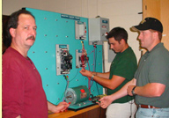
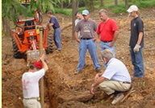

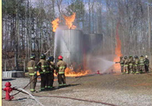
Why Use Contextual Strategies?
Adult students don’t want to learn in a vacuum.
No longer motivated by “how can I pass this class” but by “how is this course relevant to my future career?”
Understanding real-world connections to course content increases student engagement, leading to:
  Persistence
  Successful Transitions
Notes:
Facilitator prerequisites:
Familiarity with
National Research Council. (2012). Improving Adult Literacy Instruction: Options for Practice and Research. Committee on Learning Sciences: Foundations and Applications to Adolescent and Adult Literacy, A.M. Lesgold and M. Welch-Ross, Eds. Division of Behavioral and Social Sciences and Education. Washington, DC: The National Academies Press. pp. 128-129
http://www.nap.edu/openbook.php?record_id=13242&page=128
Crawford, M. (2001). Teaching Contextually: Research, Rationale, and Techniques for Improving Student Motivation and Achievement in Mathematics and Science. Waco, TX: Center for Occupational Research and Development. http://www.cord.org/uploadedfiles/Teaching%20Contextually%20(Crawford).pdf
Talking points: Lead participants back to the idea that contextualized instruction is a natural fit for career pathways.

Slide 149

Why use contextual strategies?
Los Angeles Trade-Technical College learners from the Utilities and Construction Prep Program talk about the benefits of a contextualized curriculum.
http://www.youtube.com/watch?v=4L781Z99KFc
Notes:
Facilitator prerequisites:
National Research Council. (2012). Improving adult literacy instruction: Options for practice and research. Committee on Learning Sciences: Foundations and Applications to Adolescent and Adult Literacy, A.M. Lesgold and M. Welch-Ross, Eds. Division of Behavioral and Social Sciences and Education. Washington, DC: The National Academies Press. pp. 128-129. Retrieved from: http://www.nap.edu/openbook.php?record_id=13242&page=128
Crawford, M. L. (2001). Teaching contextually: Research, rationale, and techniques for improving student motivation and achievement in mathematics and science. Waco, Texas: Center for Occupational Research and Development. Retrieved from http://www.cord.org/uploadedfiles/Teaching%20Contextually%20(Crawford).pdf
Activity: Watch the video and have participants reflect on the video and share what they learned about contextual strategies.
In this video clip we hear from adult learners in a construction program at the Los Angeles Trade-Technical College’s Career Advancement Academy that teaches basic skills with practical applications—leading to learner understanding, engagement, and excitement.
Link to video – Utilities and Construction Prep Program: http://www.youtube.com/watch?v=4L781Z99KFc
Talking points:
Lead participants back to the idea that contextualized instruction is a natural fit for career pathways.
Adult students don’t want to learn in a vacuum.
Adult students are no longer motivated by “how can I pass this class or the GED?” but by “how is this course relevant to my future career?”
Understanding real-world connections to course content increases student engagement, leading to:
Persistence
Successful Transitions

Slide 150
UNPACKING CURRICULA:
YOUR TURN!
(SMALL GROUP ACTIVITY)

Slide 151
Session 6: Learning Objectives
Participants will:
Apply what they have learned and collaboratively unpack an Adult Career Pathway resource.
Brainstorm adaptations of the resource that will extend its usefulness in other pathways or instructional settings.

Slide 152
Instructions for Group Activity
Each table will be given an instructional resource LINCS Resource Center.
Follow the template provided to unpack the resource as a group.
Discuss adaptations for different settings.
Answer the reflection questions.
Report your table’s conclusions to the entire group.
Notes:
Handouts #8 and #9-12
Talking points:
Go over the instructions for the group unpacking activity. Each participant should have a copy of Handout #8, the unpacking template. Each table or small group should have several copies of one of the resources 8 that they will read and analyze together.
The template contains space for identifying characteristics covered previously, but the reflection questions ask participants to take the activity to the next level.

Slide 153
Resources for Unpacking by Small Groups
ABE Writing and Communication: Realtor Role Play
GED Math: Calculating Body Mass Index
ABE Math: Welding—Cutting Pipe
ESL Reading, Listening, Communication: Assembly
Notes:
Talking points:
Each small group or table will receive several copies of one of these resources to unpack.

Slide 154
Template for Unpacking ACP Resource
Lesson Title:
Career Pathway:
Workplace Context:
Courses for Implementation:
Skills and Concepts Addressed:
  Reading, Writing, Listening/Speaking, and Mathematics
  Technical
  Employability
Learner Engagement Strategies: REACT
Notes:
Handout #10: Unpacking Career Pathways Contextualized Instructional Materials
Talking points:
Participants will notice that they are unpacking a resource by identifying characteristics with which they are familiar. They are also asked to identify the title of the lesson and the courses in which it might be implemented, as foreshadowing to the individual lesson design project they will begin in today’s last session.
Ask the whole group whether they have any questions before they begin.

Slide 155
Instructions for Group Activity
Each table will be given an instructional resource from the LINCS Resource Center.
Follow the template provided to unpack the resource as a group.
Discuss adaptations for different settings.
Answer the reflection questions.
Report your table’s conclusions to the entire group.
Notes:
[Duplicate slide so that facilitator can display the activity instructions without backtracking to earlier slide.]
Give participants 15-20 minutes to unpack the resource. Float from group to group to answer questions. When it looks like all groups have nearly completed the template, give each participant a copy of Handout #12 and advance to the next slide.

Slide 156
Stop and Share:
As you unpack the resource given to your table, keep the following questions in mind. After your group has completed the unpacking template, come back to these questions and discuss them together.
  In what settings could this lesson be used?
  Which of the non-technical skills could easily be taught in the context of other career pathways?
  What learner engagement strategies would you add to the lesson to increase its effectiveness? Please describe.
Notes:
Stop and Share handout on back of #8--Reflection on Unpacking a Career Pathways Contextualized Resource (each participant receives a copy)
Talking points:
Give the groups about 10 minutes to discuss these questions. Reconvene the whole group and ask for responses from a representative from each group.
The first two questions ask participants to consider how the lesson might be adapted for other settings or used in other career pathways. Ideally, this is the mindset (flexibility, creativity) they will bring to examination of any of the resources in the LINCS collection. We want participants to ask themselves, “How can I use this?” “How can I adapt this for my classroom?”
The third question asks participants to think about learner engagement strategies and lesson improvement. Keeping in mind that more students may be reached by multiple modes of teaching a concept, we want participants to ask, “What else would I do with that lesson?” (Again, flexibility and creativity are key.)

Slide 157
ACTIVITY: Real World Assignments
Page 15 in your workbook
Identify how you can integrate one or more of these activities into your contextual lesson.
Reading and writing technical material
Conducting research
Evaluating resources
Creating and giving presentations
Collecting, analyzing, and explaining data
Troubleshooting and problem-solving
Evaluating their own and peers’ work
Working collaboratively

Slide 158
Contextualizing YOUR Lesson Plan
The remainder of our time together is allocated for you to take the lesson you brought today
You are going to modify it to make it more contextual using the learning theories and examples we’ve provided throughout the day.
Before you start, let’s walk through the basic tenants we are looking for on
WORKING FROM Pages 16- 18 IN YOUR WORKBOOK
EXAMPLE PROVIDED ON PAGE 23
Notes:
Trainer Notes:
The remainder of our time together is allocated for you to take the lesson you brought today and modify it to make it more contextual using the learning theories and examples we’ve provided throughout the day. Before we let you loose, let’s walk through the basic tenants we are looking for found on pages 16- 18 in your notebook.
Read the slide:
Lesson /Unit Title – engage the students with a flashy title that may pique their interest.
Duration of the Lesson – how long will this lesson or unit be?
Career Technical Course Standards – what standards or objectives will be met by the students completing this lesson?
Academic Standards – what state or CCSC standards will be met by the students completing this lesson
Employability/soft-skills standards/objectives – if your state or district has employability skills competencies defined, which ones will be addressed in this lesson?
Business/industry and/or external partner connection – how will you make this scenario real to the students? Who or what is your business partner, this could be a non-profit, religious organization, business, industry, governmental agencies or other community partner. The purpose is to make the scenario real and for the students to be accountable to someone other than the instructor and themselves.

Slide 159
Contextualizing Your Lesson
Lesson /Unit Title – engage the students with a flashy title that may pique their interest.
Duration of the Lesson – how long will this lesson or unit be?
Career Technical Course Standards – what standards or objectives will be met by the students completing this lesson?
Academic Standards – what state or CCSC standards will be met by the students completing this lesson
Employability/soft-skills standards/objectives – if your state or district has employability skills competencies defined, which ones will be addressed in this lesson?
Business/industry and/or external partner connection – how will you make this scenario real to the students? Who or what is your business partner, this could be a non-profit, religious organization, business, industry, governmental agencies or other community partner. The purpose is to make the scenario real and for the students to be accountable to someone other than the instructor and themselves.

Slide 160
Contextual lesson plan
Resources: What resources should the students should be exposed to during the investigation process that will give them exposure to accessing accurate information? (library, community leaders, journals, online resources, etc.)
Integrated technology: Identify the media, such as web 2.0 applications, video, audio, Skype, etc. made available to students during the lesson and what students are permitted to use. (this may be dependent on the districts or schools policies, strongly encourage “BYOT - Bring your own technology”)
Design a real-life experience students will have to address - in 3 – 5 sentences outline the scenario and provide the impetus for solving the problematic situation.
Story board how it looks visually: if you have the skills and the time after this workshop, create a video of the situation instead of having it in written text to better engage the students, as this generation is more visual than previous generations. You can use movie-time, i-movie, or PowerPoint to create the video. Pictures and music can enhance the experience tremendously. http://www.storyboardthat.com

Slide 161
Contextual lesson plan
R.E.A.C.T.
Lesson Rigor
  Webb’s Depth of Knowledge
Gardner’s Multiple Intelligence(s)
Special needs adaptation
Assessment strategies (aligned to course standards)
Evaluation method (external accountability)
Notes:
Trainer Notes:
Apply your scenario in your lesson and experience using the R.E.A.C.T. model. This is a great way to confirm that the lesson is meaningful and contextual.
Chose a learning theory that appeals to you. Apply your scenario to the following to your lesson as it measures to the rigor of the theories:
Webb’s Depth of Knowledge
Blooms Taxonomy
Rigor and Relevance Framework
Make changes or modifications to your lesson so you are addressing more rigor.
Gardner’s Multiple Intelligence(s) : identify the multiple intelligences the lesson will include.
And finally, provide some form of modification for a student with special needs. Think about a student you’ve had in the past who has struggled in your classroom. How could your lesson be modified for the student so that he/she has the same learning experience and is challenged in the classroom?
Identify how you will assess the students throughout the lesson. These can be formal or informal assessments, they should apply to the project or scenario and they should measure the academic, CTE and employability skills standards/objectives you outlined in the beginning of the lesson.
Evaluation – how will you evaluate the overall solution to the scenario? Will you have business/industry or external partners review a group presentation or demonstration? Will you have the students submit their solutions to a state or national contest? The possibilities are endless!
Before you get started, do you have any questions regarding how to get started? We/I will circulate the room and provide assistance as needed. You have 1 hour (depending on the length of time allocated for the workshop and how long it took the trainer to get through the material) to get started on this lesson plan. After that time you will be asked to pair share, so please use this time wisely so your partner or another team can have something to review.
You may work in collaborative teams or independently.

Slide 162

Get Ready, Get Set, Let’s CONTEXTUALIZE!

Slide 163
Pair Share
Pair with a colleague and provide the peer with your newly developed lesson plan.
Use “Grading a lesson: How contextual is it?” on page 20 of your Notebook. Allow 10 - 15 minutes for independent review
Then discuss to enhance the student experience and outcomes.
Notes:
Trainer Notes:
After the allocated time, ask the participants to pair either with another individual or team.
Read: Pair with a colleague and provide the peer with your newly developed lesson plan. Allow 10 minutes for independent review, then question and answer one another to enhance the student experience and outcomes.

Slide 164
For Further Study: Free Contextualized Materials
Preparing Workers for the 21st Century (Michigan)
  http://maepd.org/lib-preparingworkers.html
GED to Careers Curriculum Guides (Virginia)
  http://valrc.org/resources/instruction.html
Contextual Education for the GED (Michigan)
http://www.maepd.org/lib-contextualed.html
Hubbs Center Bridge Curricula (Minnesota) http://hubbs.spps.org/bridges_project.html
Texas Adult Education Standards and Benchmarks Lesson Plan Bank
http://www-tcall.tamu.edu/taesp/lessons/bankabelessons.html

Slide 165
For Further Study: Research
Improving Adult Literacy Instruction: Options for Practice and Research
http://www.nap.edu/catalog.php?record_id=13242
Facilitating Student Learning Through Contextualization
Dolores Perin, February 2011, CCRC Working Paper No. 29
http://ccrc.tc.columbia.edu/Publication.asp?UID=866

Slide 166
Integrated Instructional Planning
Step 1: Create a Curriculum Map (scope and sequence) has defined topics and clustered standards (curriculum map)
Step 2: Organize Instructional Units for a Level (for an instructional period) (Units of Instruction)
Step 3: Align Units with Identified Lead or Main CCR & Employability Skills Standards
Step 4: Identify an Appropriate Assessment for the Learning Objectives (standards)

Slide 167

Curriculum Mapping
A curriculum map is a flexible planning tool to organize an instructional approach to contextualized teaching and learning. It can help in the development of lesson plans using a lesson plan template.
Notes:
So you are thinking how do I put this all together? An Instructional map can help.
Academic, foundational Employability Skills,

Slide 168
Resources and Examples from K-12
https://www.engageny.org/resource/grade-7-mathematics-module-1
http://www.freeportschools.org/Assets/Curriculum_Office/120315_CURRICULUM.pdf?t=635847509991170000

Slide 169
Step 1: Create Curriculum Map
What is the length of time of a unit of instruction for each content area and educational level?
Multi-level? How will you organize your classroom?
What “theme” will you give each unit?
What are the essential question(s) for the units?
  Essential questions should be written so that learners are able to understand terminology in the question. The questions identified for a unit of instruction should be logically sequenced. The collaborative exercise among teacher team members to create essential questions will enrich the content of the unit.
Notes:
Handout: multi-level classroom
Handout: planning guide
Handout: Curriculum Map

Slide 170

Practice: Let’s Co-create a Map

Slide 171
Curriculum Map
Time Period of Instructional Map (# of weeks/days; class periods/minutes) | Class Structure: (Check applicable items) Open entry Managed Enrollment | NRS Levels: (circle applicable items) Pre-secondary: ABE 1 2 3 ESL 1 2 3 4 5 Intermediate & Secondary: ABE 4 ASE 5 6 ESL 6
Instructional Strands
What academic skills will students know and be able to do? (AE CCRS) List standards | What employability skills will the students learn? List skills | What career context will be used to contextualize instruction? (Career Awareness, CTE, or Career Pathways)
Unit of Instruction Name--
List the primary learning activities below and indicate which of the three instructional strands will be integrated into each. |  | Identify the activities you will use to assess students’ ability to demonstrate their understanding of new concepts and to apply new skills.
Academic Employability Career | Academic Employability Career
Academic Employability Career | Academic Employability Career
Resources/Materials Needed:
Your TURN!
Notes:
HANDOUT: Instructional Map Sample
Handout: Instructional Map Blank

Slide 172

Step 2: Organize Instructional Units
What is an instructional unit?
A sequence of lessons tied together.
Notes:
Once we have the map we can then build the units of instruction within the

Slide 173


Unit
A road map of lead and supporting standards clustered in a meaningful way to reach a learning destination
Lessons
A series of targets the student must reach within a unit. They are sequenced to engage and scaffold the student into arriving at the unit destination.
Each lesson develops around selected lead and supporting standards to focus and measure student acquisition of knowledge and skills.

Slide 174

When you enter the classroom, how do you approach your teaching?
What questions do you ask yourself?

Slide 175

Begin with the end in mind…
#1-Are you asking…
What activities will I have them do?
What books will I use?
What assignments will I give them?
What will I do about my student,
who shows up late and leaves early?
#2- Or are you asking…
What will my students learn today?
To what degree will they learn it?
What is the best way to teach
them how to learn it?
How will I know they learned it?
What will be their purpose for learning it?
Reeves, Ann R. (2011). Where Great Teaching Begins. ASCD: Alexandria, VA.

Slide 176

Activity: Share Curriculum Maps
Pair up with a colleague
Each share your curriculum map
Use “Critical Friends” principles to provide feedback
Prepare to discuss in whole-group

Slide 177
Before we wrap up…
Clarifications on today’s:
Content?
Processes?
Next steps?
Notes:
Talking points:
Is anything about today’s content—career pathways, contextualized instruction, the resource collection, or anything else—that you have a question about?
Is there anything about the individual lesson development process that needs clarifying?
Next steps? Next slide…

Slide 178
Resources & Questions
Michelle Carson
785.250.1882
michelle@carsonct.com
Libby Living-Eassa
772.559.8011
Libby.livings-eassa@thedivergentgroup.com

