Slide 1

ARKANSAS
Adult Career Pathways: Institute 4
August 2016
Michelle Carson & Libby Livings-Eassa

Slide 2
ALL-IN:
Counseling & Guidance in a Career Pathways System
      August 5, 2016

Slide 3
Planning for Action
DAY 2
Good Morning and Look Back
ALL-IN: Counseling & Guidance in a Career Pathways System
  Integrating Career Awareness
  Digital Literacy & Technology Integration
    Best Practices & Resources
  Who’s On First? Environmental Scan
  Sustainability and Strategic Planning
What’s Next & Wrap-Up

Slide 4
I learned…
I still have questions about…

Slide 5

Career Pathways/Programs of Study
“ROAD MAPS,” jointly produced by educators and employers, showing the connections between education and training programs and jobs in a given sector at different levels.
Career Pathway Primer & Planning Guide,
Davis Jenkins, University of Illinois at Chicago
Notes:
Trainer Notes:
The terms Career Pathways and Programs of Study are sometimes used interchangeably and both may have a variety of definitions. This is an example of one definition that resonates with some audiences.

Slide 6

Career Pathways
A road map that identifies the skills and knowledge necessary to pursue a full range of career opportunities
within a career pathway.
Secondary Transition State Planning Institute: Building for the Future May 2008
Notes:
6
Our work revolves around Career Pathways……Which is basically a system that has at the heart…a road map. This road map is usually pretty clear with course sequences and service for the traditional study transitioning from high school to ps ed and training

Slide 7
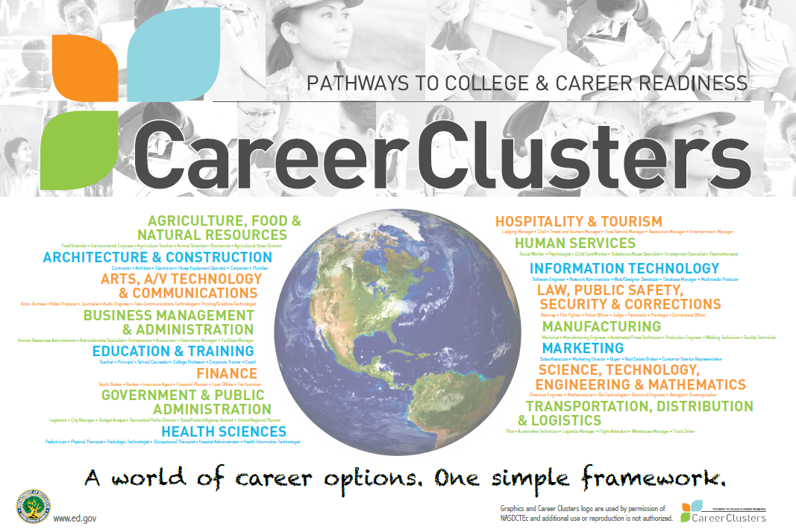
Notes:
Trainer Notes:
Make sure the audience knows the website for reference: www.careertech.org
12 broad categories

Slide 8
Activity: Page 3
www.careerclusters.org

Slide 9
Career Pathways Planning & Guidance

Slide 10
Whose Job Is It?

Slide 11
Counselors as Facilitators

Slide 12
Career Counseling
Delivered By All for All
Community Volunteers
Classroom Teachers
Support Staff
Post Secondary
Personnel
Community/
School
Liaison
Employers
Parent/Guardian
Local School
Administrators
School
Counselors
School To Work Coordinators
Notes:
12
To reach all students it is necessary to involve all segments of the school and community.

Slide 13
Framing your role
What is your role in a career pathways system?
Notes:
Trainer Notes:
Ask participant what is their role in a Career Pathways system?

Slide 14
Counselors as Facilitators:
Work to Engage Other Partners
Career & Technical Education Educators
Adult Education Educators
Post-secondary Educators
Administrators
Career Navigators
Business/Industry partners (advisory boards)
Parents & students
Workforce boards & chambers of commerce
Military
Community Partners
Notes:
Trainer Notes:
To reach all students it is necessary to involve all segments of the school and community.
COUNSELORS LEAD the team
FACULTY – assist in process of integrating career info into the curriculum framework
ADMINISTRATORS – are critical for the program to be a part of the school improvement process
EMPLOYERS – ensure the program is on target with required K & S and support WBL activities
COLLEGE REPRESENTATIVES – 2 & 4 year provide smooth transition
PARENTS - attitudes affect student’s career choices
COMMUNITY LEADERS – serve the economic development interests of the entire community

Slide 15
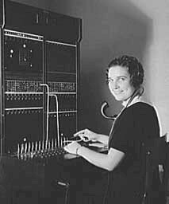
Communication is KEY!
Explain/promote Career Pathway Programs to . . .
  Students
  Parents
  ALL Educators
  ALL Administrators
  Boards & Governing Entities
  Business/Industry
Notes:
The cost of NOT providing career guidance is exorbitant . . . .
High PS Tuition!
Lost DREAMS
Effective Career Guidance . . .
Helps students attain ACADEMIC COMPETENCE through meaningful educational opportunities
REDUCES and may even eliminate the cost of remediation
Enhances students’ ability to pass HIGH STAKES assessments

Slide 16
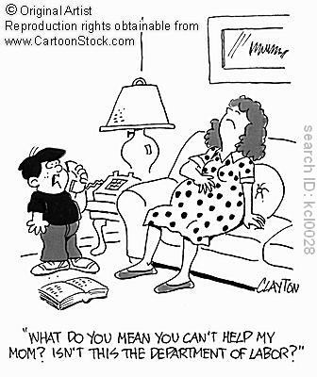
What Stakeholders Should Know &
Communicate About the Workforce
Labor Marketing Information (LMI)
  Bureau of Labor Statistics – Federal
  State Departments of Labor
Education, Skills, and Wages
  Bureau of Labor Statistics www.bls.gov/oes
  O’NET www.onetcenter.org
  Occupational Outlook Handbook

Slide 17
Who is MOST responsible for
building a college going culture?
Parents: How knowledgeable would you say you are about the source of information & counsel
on college education, such as admissions information, scholarships, & grants, etc.?
74% of parents – NOT VERY KNOWLEDGEABLE
Notes:
Predictably, parents, students, & teachers overwhelmingly agree that parents are most responsible for encouraging their child to go to college. But 74% of parents say they are not “very knowledgeable” about where to access information & resources.

Slide 18
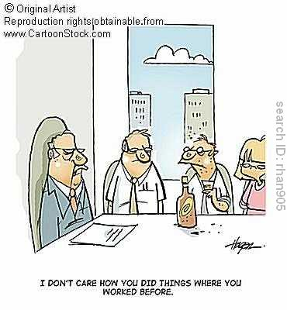
Need for Career Planning
ONLY 32% of people planned and chose their job
With planning comes opportunity, but FAR TOO MANY people do NOT understand or implement a career planning process
Impact of career planning is stronger than any psychological influence on people
Taking Charge Of Your Career Direction – R.D. Lock

Slide 19
Tell me AGAIN why the 10 Components and the 6 Key Elements are so important!
Notes:
Trainer Notes:
The Office of Vocational and Adult Education (known as OVAE) has issued a Design Framework to clarify/define Program of Study requirements as outlined in the 2006 Perkins legislation.
The entire document can be found online at http://cte.ed.gov/docs/POSLocalImplementationTool-9-14-10.pdf
The document outlines the 10 supporting elements of a Program of Study and provides useful quality assurance markers for each component. The document also suggests readiness & capacity guidance for each component. We will be looking at the OVAE Program of Study Design Framework in detail and then provide you time to evaluate your current or proposed Career Pathways at the local, regional or state level.
The Framework was developed with input from experts from the field with experience implementing Tech Prep, Career Clusters®/Career Pathways, and career majors.

Slide 20
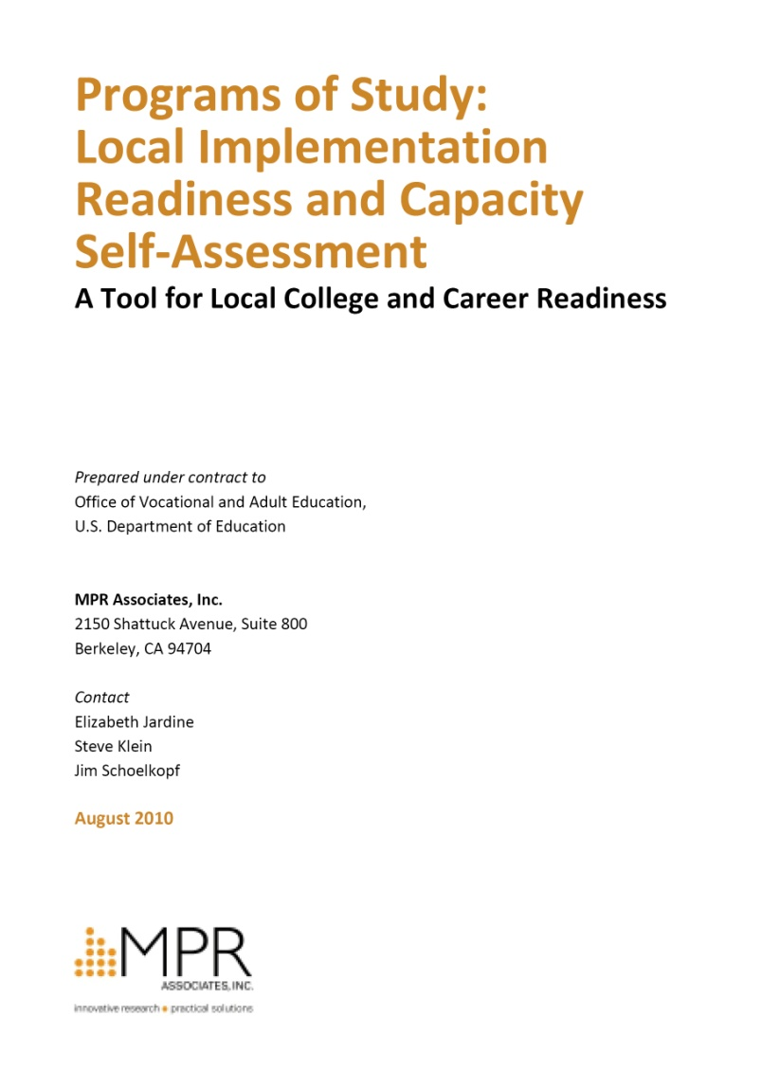
POS: 10 Components
“…OCTAE has issued a design framework to clarify/define POS/career pathways requirements (Perkins) …”
10 supporting elements
Useful quality assurance marker
Provides suggested readiness & capacity guidance
Notes:
Trainer Notes:
The Office of Vocational and Adult Education (known as OVAE) has issued a Design Framework to clarify/define Program of Study requirements as outlined in the 2006 Perkins legislation.
The entire document can be found online at http://cte.ed.gov/docs/POSLocalImplementationTool-9-14-10.pdf
The document outlines the 10 supporting elements of a Program of Study and provides useful quality assurance markers for each component. The document also suggests readiness & capacity guidance for each component. We will be looking at the OVAE Program of Study Design Framework in detail and then provide you time to evaluate your current or proposed Career Pathways at the local, regional or state level.
The Framework was developed with input from experts from the field with experience implementing Tech Prep, Career Clusters®/Career Pathways, and career majors.

Slide 21
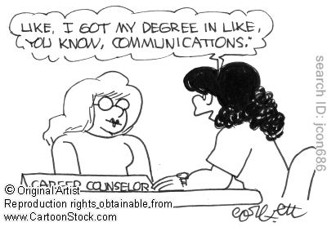
Guidance counseling and academic advisement
Based on state/ local guidance and counseling standards
Ensure up-to-date information
Offer information and tools about postsecondary and career options
Offer resources to identify career interests and aptitudes
Provide information and resources to parents
Offer web-based resources/tools
Notes:
Trainer Notes: CHAPTER 12
Guidance counseling and academic advisement help students to make informed decisions about which Program of Study to pursue. Quality programs:
Are based on state and /or local guidance and counseling standards
Ensure that guidance, counseling, and advisement professionals have access to up-to-date info about Program of Study offerings
Offer information and tools to help students learn about postsecondary and career options, including prerequisites for particular Program of Study
Offer resources for students to identify career interests and aptitudes and to select an appropriate Program of Study.
Provide information and resources to parents to help children prepare for college and careers, including workshops on financial aid.
Offer web-based resources/tools; such as student financial assistance.

Slide 22
Activity – Page 2:
How can we involve different groups in the career development process?
Report Out
Team member | How can this group be involved in the career development process?
Career & Technical Education Educators
Adult Education Educators
Post-secondary Educators
Career Navigators
Administrators
Business/Industry partners (advisory boards)
Parents & students
Workforce boards & chambers of commerce
Military
Community Partners

Slide 23
Career Guidance Support
Legislation & Standards
American School Counselors Association
National Career Development Association
Arkansas Career Navigators & WAGE programs
Notes:
Trainer Notes:
Short & Sweet
Legislation & Standards-Career guidance services are provided by professional counselors and certified career development facilitators but also, unfortunately, by an array of others who lack sufficient training. Steps to meet the need for standardization are being taken by the Council for Accreditation of Counselors and Related Educational Programs (CACREP), which accredits counselor education programs that meet their stringent standards. Many states have developed their own standards for career guidance, many based on the American School Counselors Association (ASCA) national standards and the National Career Development Guidelines.
American School Counselors Association--The American School Counselor Association (ASCA) supports school counselors' efforts to help students focus on academic, personal/social and career development so they achieve success in school and are prepared to lead fulfilling lives as responsible members of society.
National Career Development Guidelines--NCDA inspires and empowers the achievement of career and life goals by providing professional development, resources, standards, scientific research, and advocacy.
State Examples (Trainer Note: SC, others)

Slide 24

“ROAD MAPS,” jointly produced by educators & employers, showing the connections between education & training programs and jobs in a given sector at different levels.
Career Pathway Primer & Planning Guide: Davis Jenkins, University of Illinois at Chicago
Career Pathways

Slide 25
Keeping Students in School
Notes:
If pathways aren’t developed more likely to have students leak out of the pipeline. Also, helps them to be able to re-enter the pipeline if the multiple entry exit points are already established.

Slide 26
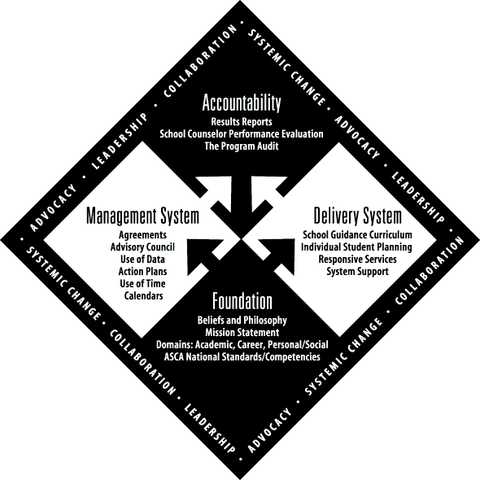
National School Counseling Models
Academic – Career – Personal-Social
ACRN
Create/manage a Career Plan
Use decision-making process in planning
Use accurate, current, & unbiased career information
Master academic, occupational & employ-ability skills to reach career goals
Integrate changing employment trends, societal needs and economic conditions into career plans
ASCA
Standard A:
  Develop Career Awareness
  Develop Employment Readiness
Standard B:
  Acquire career information
  Identify career goals
Standard C:
  Understand relationship between personal qualities, education, training and work
  Acquire knowledge to achieve career goals
  Apply skills to achieve career goals
American Career Resources Network (ACRN)
  http://www.acrnetwork.org/ncdg.htm
American School Counseling Association (ASCA)
  http://www.schoolcounselor.org/
Notes:
School counselors have three areas of RESPONSIBILITY – academic, career, and personal-social. This slide shows the ACRN and ASCA guidelines for the CAREER component ONLY.

Slide 27
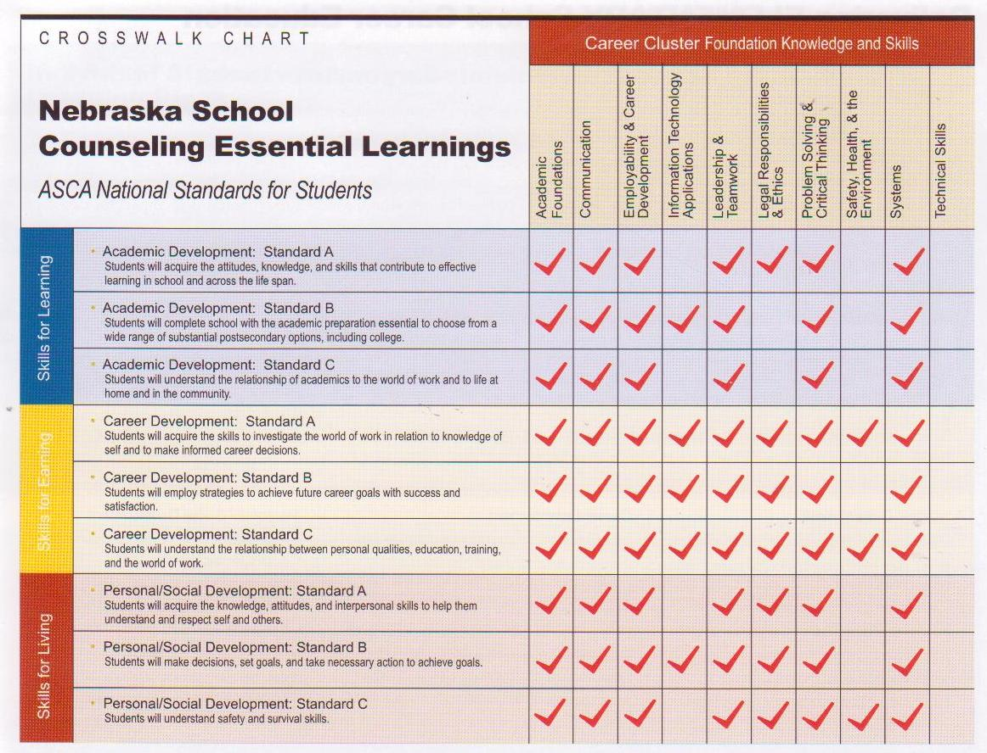
Alignment of Competencies
www.nde.state.ne.us/cared
Notes:
Remarkable similarities were found when the ASCA national standards were crosswalked to the Career Cluster foundation knowledge and skills statements.

Slide 28
ASCA National Model Executive Summary

Slide 29
Moving FROM
TO
Emphasis on at-risk students | Including all students
Crisis-driven | Curriculum-driven
“On call” approach to use of time | Calendared time
Delivered only by teachers or counselors | Delivered collaboratively by counselors, instructors, and community members
Owned by teacher/counseling staff only | Owned and supported by the community
Comprehensive Counseling Programs

Slide 30

Counseling Curriculum
Lower Levels ABE/ESL – Career Pathways Awareness
Intermediate Levels ABE/ESL – Career Exploration/Pre-Bridge
ASE– Career Pathways Preparation & Bridge or Apprenticeship Programs/ Career Management
Notes:
The cost of NOT providing career guidance is exorbitant . . . .
High PS Tuition!
Lost DREAMS
Effective Career Guidance . . .
Helps students attain ACADEMIC COMPETENCE through meaningful educational opportunities
REDUCES and may even eliminate the cost of remediation
Enhances students’ ability to pass HIGH STAKES assessments

Slide 31
Lower Levels ABE/ESL: Career Pathways Awareness
Individualized Learning Plan OR IDP
Students should learn ….
  about different kinds of work
  about goal setting and decision making
  what it means to be a good worker
  about Career Clusters®
  informal career inventories to identify possible occupations
  assessment tools to explore their skills
  career decision-making models (introduction)
  about occupations in the various Career Clusters®
  to develop good work-place skills
Notes:
Trainer Notes:
Highlight strategies on the slide.

Slide 32
Lower Levels ABE/ESL: Career Pathways Awareness
Divide the 16 Career Clusters and introduce each cluster with activities
  i.e., Career Cluster/Guidance = Agriculture, Food, and Natural Resources ; Transportation, Distribution, and Logistics; Law, Public Safety, and Security
Assign all 16 clusters to each grade with progressive activities.
Notes:
Trainer Notes:
Highlight strategies on the slide.

Slide 33
Value-added activities for all grade levels
Adapted from: Georgia Department of Education Career Cluster Awareness Activities Guidelines
Field trips to local cluster-related business
Local cluster-related speakers
Career Fair to highlight clusters
Poster/Poetry contest
Aligned career clusters during the month of November (Career Month)
Career Interviews
Media Specialist selects a cluster-related book for media lesson; creates a bulletin board from cluster-related books
Career Planning Family Involvement
Elementary Transition Activities
Postsecondary Education Awareness
Career Cluster Door Decoration
Notes:
Trainer Notes:
Highlight strategies on the slide. Ask participants to share other strategies that they use in their school for career awareness in grades 1-5.

Slide 34
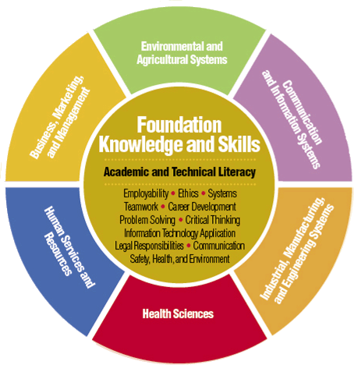
Career Awareness
Introduce Foundation K&S and Six Career Fields only
Notes:
Introduction of the Career Cluster Model begins in the elementary grades with CAREER AWARENESS. In the Nebraska Model, the six Career Fields and Foundation K&S are introduced at the elementary level.

Slide 35
Intermediate Level ABE & ESL: Career Pathways Exploration & Pre-Bridge
Students should…
be introduced to career pathways in each Career Cluster
take a career related assessments
identify jobs within career pathways requiring different levels of education
identify and explore sources of career information
participate in service learning, job shadowing, and mentoring
continue to develop good work-place skills
choose a pathway based on assessment, exploration/investigation
develop the individual learning plans to include both academic and career pathway course planning
begin the transition process to ASE/PSE
Notes:
Trainer Notes:
Highlight strategies on the slide. Ask participants to share other strategies that they use in their school for career awareness/exploration in the middle grades.

Slide 36
Trending Federal IDP Requirements
• Career goals
• Programs of study (course sequence)
• Interest inventories
• Postsecondary plans
• Work-based learning experiences
Resumes
• Test scores
• Grades
• Examples of work (work portfolios)
• Other
Notes:
Trainer Notes:
At the core of every career pathways career development system is the individual learning plan (may be called something different in your state, e.g., individual career plan, graduation plan). The individual learning plan is a personalized document that students develop with their counselors and/or counseling teams to chart their progress toward their academic and career goals during each school year, to ensure that they are on the path to graduation, and to determine what resources and tools are required for success in their chosen career pathways after graduation. The individual learning plan can be electronic. Each school must determine how and when individual learning plans will be accessed by students and updated. The individual learning plan could include:
• Career goals
• Programs of study (course sequence)
• Interest inventories
• Postsecondary plans
• Work-based learning experiences
• Resumes
• Test scores
• Grades
• Examples of work (work portfolios)
• Other
Individual learning plans need to be “owned” by the student and updated frequently. They should be living documents/files that
are at the core of the career development system. There should be regular opportunities to plan and assess student progress in the
course sequence that meets the prerequisites for enrollment in postsecondary as well as academic requirements for graduation in their career pathways.

Slide 37
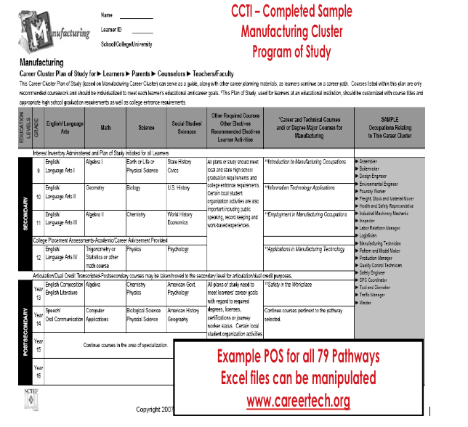
Activity:
Page 4 & handout
Review sample
ACP programs of study
Notes:
It’s a secondary example. Legislation is showing that this is what is coming.

Slide 38
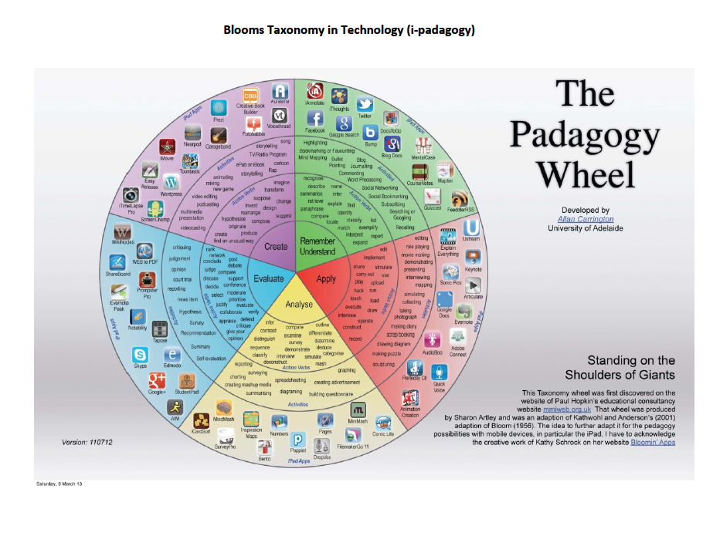
In Day 1 Workbook

Slide 39
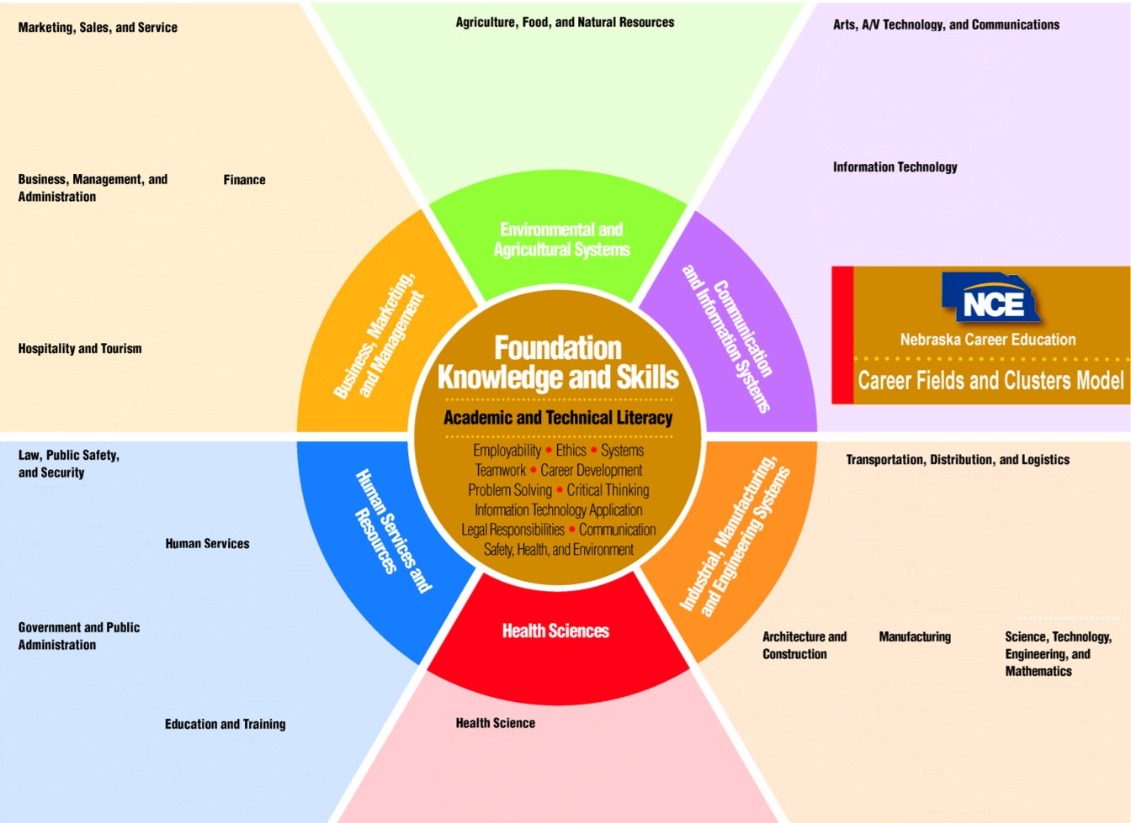
Intermediate Level ABE/ESL Career Exploration
https://www.education.ne.gov/nce/c4c/
Create 4+2+2 Individual Learning Plan for ALL Students
Notes:
Knowledge of the career cluster model is expanded in the middle grades 7 and 8 to include all 16 career clusters – but does NOT include the pathways within the clusters until the 8th or 9th grades.

Slide 40
Intermediate Levels ABE/ESL
Curriculum for Careers - C4C
Sample Timeline
Goal/Objective | Days
Self Awareness | 10
Career Fields/Clusters | 20
Knowledge & Skills | 12
Personal Learning Plan | 7
Career Exploration | 15
Career Information | 10
Postsecondary Options | 8
Flex Days | 8
Total Days | 90
Notes:
Sample MS curriculum timeline for a one semester course.

Slide 41
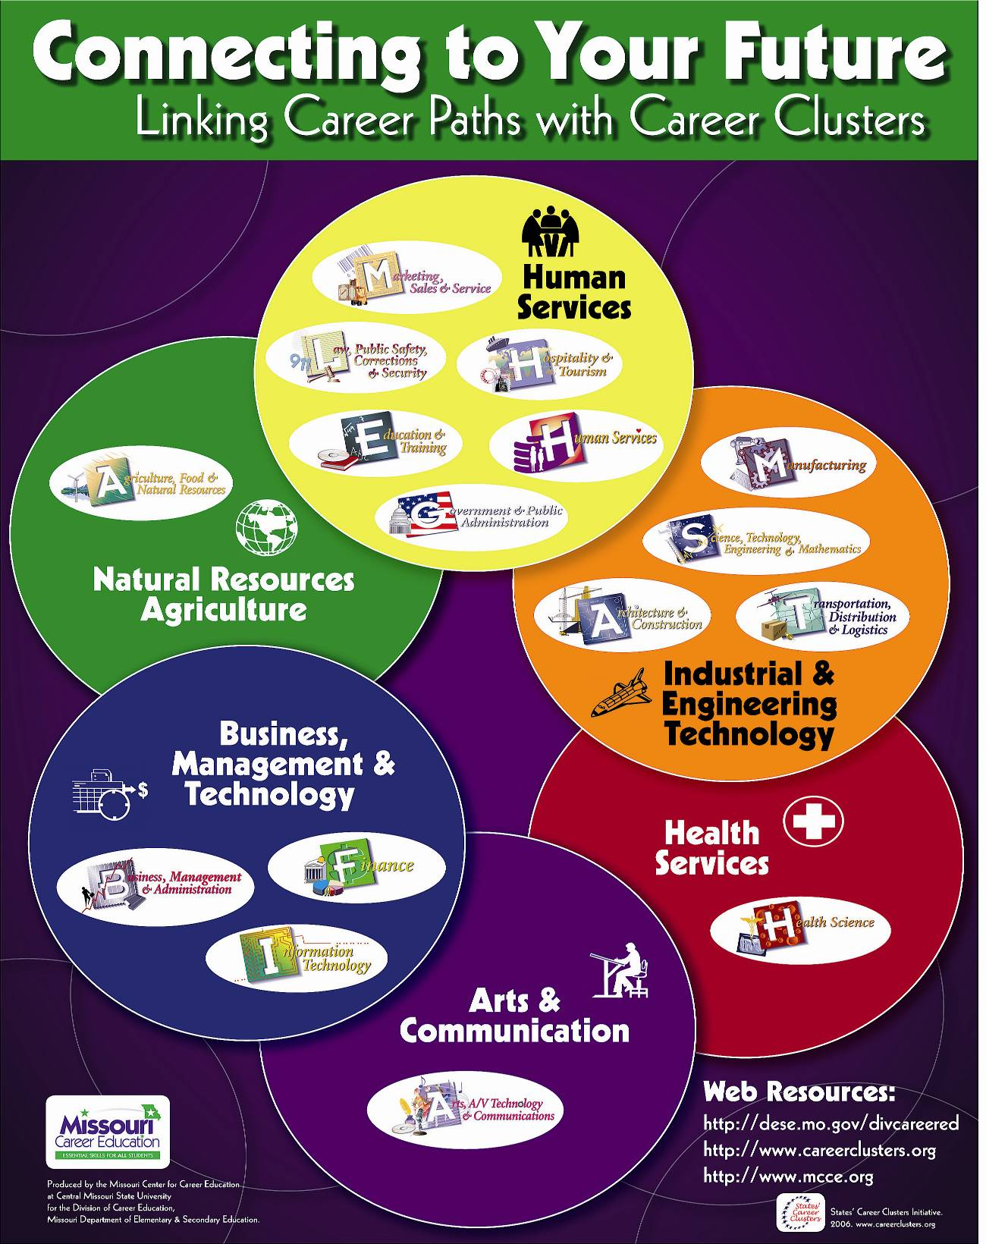
Exploring Career Clusters
A modular, hands-on approach to
career exploration by Career Clusters©
Intermediate/High Levels ABE/ESL – One Semester
Course Goals
Expose students to many different technological career fields within the Career Clusters.
Provide realistic experiences from selected technological careers within these Career Clusters.
Assist the student to gain insights into their personal interests and aptitudes with respect to the Career Fields.
Identify potential Career Fields of interest and chart a preparation/ educational plan required for entry into those fields.
Missouri

Slide 42
ASE Level: Career Pathways Prep and Bridge Programs
Students should…
review and update individual learning plan
begin to explore financial aid opportunities through a variety of websites
participate in related CTE Student Organizations and other organized activities
begin to refine good work-place skills
continue to narrow career choices within the selected career pathway
participate in job shadowing, internships and apprenticeships
take appropriate postsecondary admissions and placement assessments i.e. Compass, Accuplacer, ACT, Asset, etc..
take appropriate postsecondary admissions and placement assessments
begin the transition process into postsecondary education, the military, apprenticeship, or work
Notes:
Trainer Notes:
Highlight strategies on the slide. Ask participants to share other strategies that they use in their school for career exploration/preparation in the high school.

Slide 43
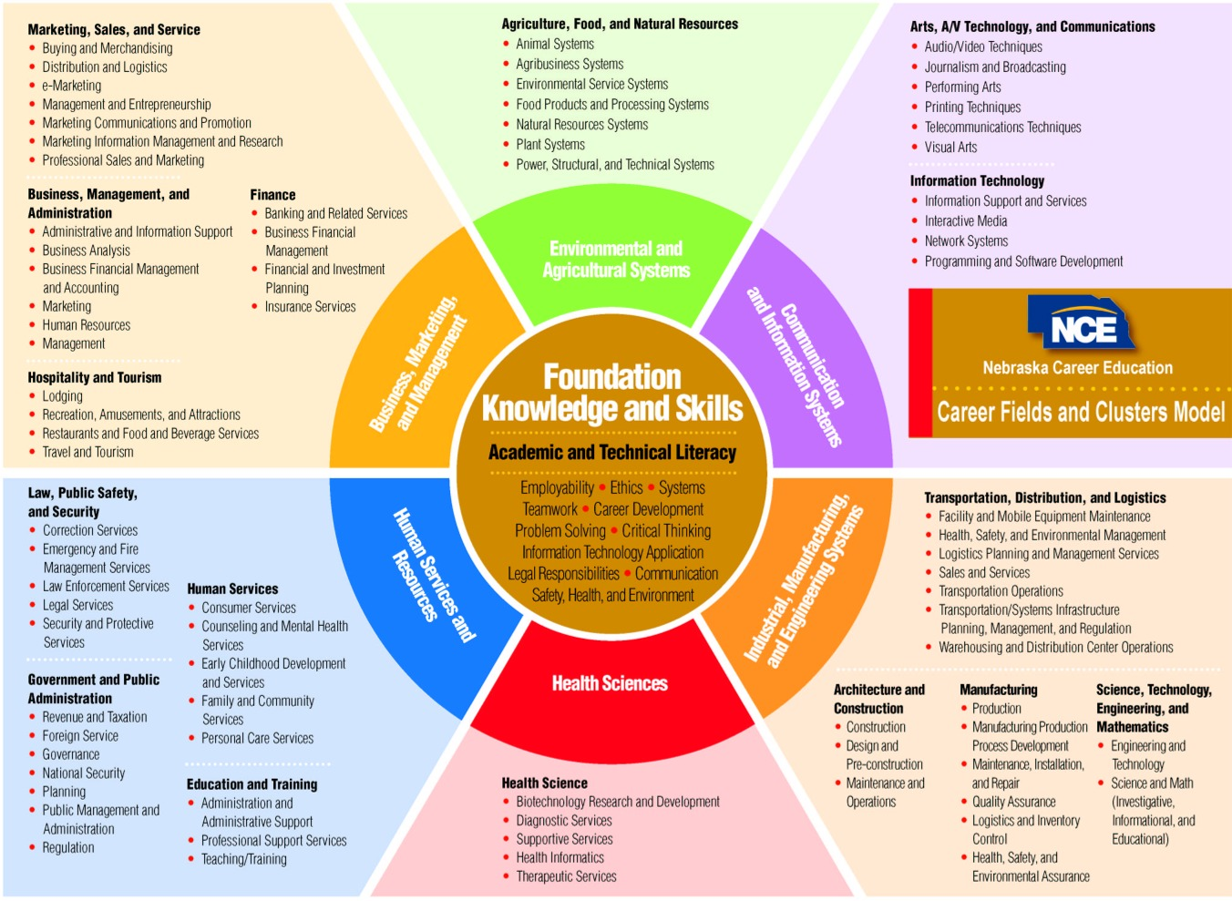

ASE Level
Career Preparation, Application, & Management
www.altechprep.org/pdfs/AlabamaSUCCESSCounselors.pdf
Notes:
The entire model is studied by students in grades 9 and higher – including adults exploring further education and/or employment.

Slide 44

Alabama Counselor’s Guide
Frequently asked QUESTIONS about career clusters
Incorporating clusters into a student’s DIPLOMA CHOICE
Talking to PARENTS about career clusters
TALKING POINTS for explaining career clusters
www.altechprep.org/pdfs/AlabamaSUCCESSCounselors.pdf

Slide 45



“Successful people understand their talents, & build their lives upon them”
  Helping people of all ages . . .
  discover their greatest natural talents/strengths
  improve their grades and increase their learning by making the most of their talents
  strategically determine a rewarding career path based on who they are as uniquely talented individuals
  maximize their potential for strengths by building on their talents rather than focusing on their weaknesses
www.gallup.org
10-14
Year Olds
Adults
High School
&
College Students

Slide 46
“Successful people understand their talents, & build their lives upon them”
www.gallup.org
Build on your strengths – Manage
your weaknesses!

Slide 47
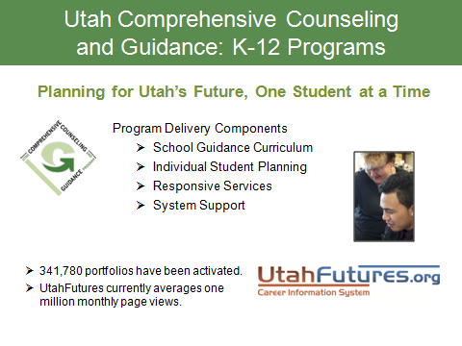
Utah

Slide 48
Activity: Great Explorations!
https://www.education.ne.gov/nce/c4c/
www.altechprep.org/pdfs/AlabamaSUCCESSCounselors.pdf
www.utahfutures.org
www.gallup.org
www.careertech.org
https://wicareerpathways.org
https://www.gadoe.org/Curriculum-Instruction-and-Assessment/CTAE/Pages/Georgia-Career-Pathways-New-Rule.aspx
Padagogy
Padagogy
Padagogy

Slide 49
Activity – Page 5: Adult Educational Functioning Level Survey
Career Development Inventory
Strategy/Activity | Awareness |  |  |  |  |  | Explore |  |  | Prepare
Introduce 16 career clusters®
Introduce specific Career Cluster®
Learn workplace skills
Field trips to local cluster-related business
Local cluster-related speakers
Career Fair to highlight clusters
Poster/Poetry contest
Aligned career clusters during the month of November (Career Month)
Career interviews
Career planning family involvement
Postsecondary education awareness
Take a career related assessments
Identify jobs within career pathways requiring different levels of education
Identify and explore sources of career information
Participate in service learning
Choose a pathway
Participate in job shadowing
Have a career mentor
Develop the individual learning plans
Begin to explore financial aid opportunities through a variety of websites
Participate in related CTE Student Organizations and other organized activities
Continue to narrow career choices within the selected career pathway
Participate in internships and apprenticeships
Take appropriate postsecondary admissions and placement assessments i.e. Accuplacer, Compass, ACT, Asset
Create a resume
Begin networking the market for possible job opportunities
Notes:
Libby has handout

Slide 53


Slide 54
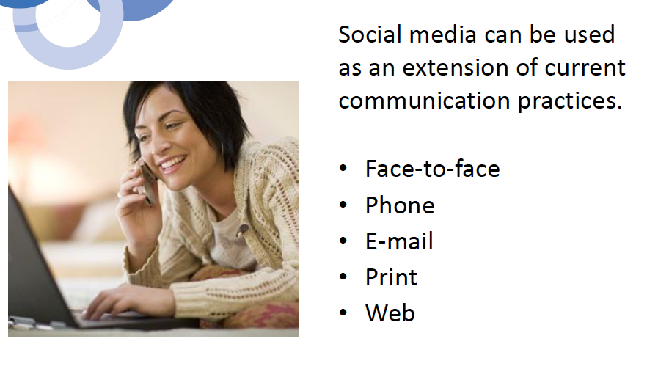

Slide 55
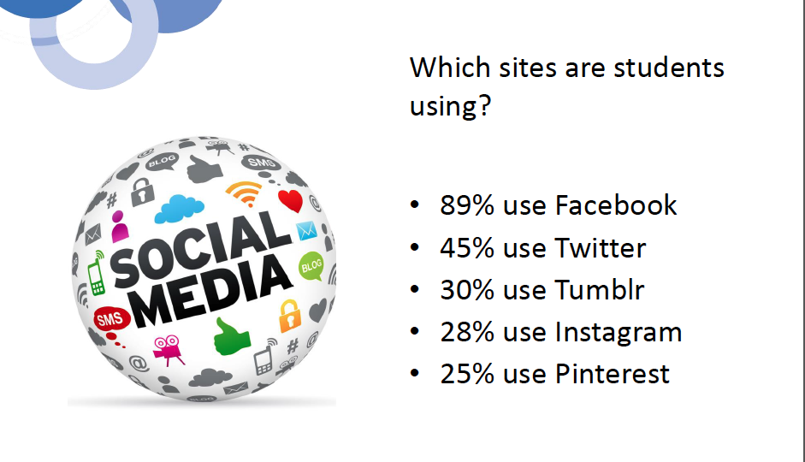

Slide 56
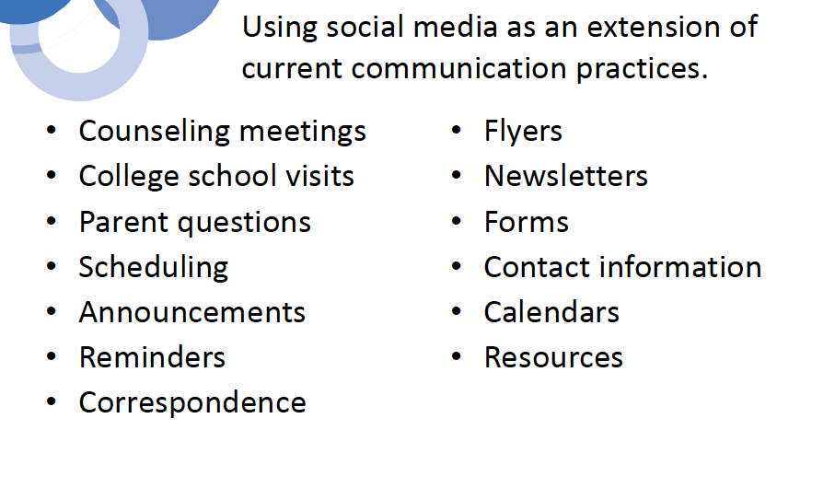

Slide 57
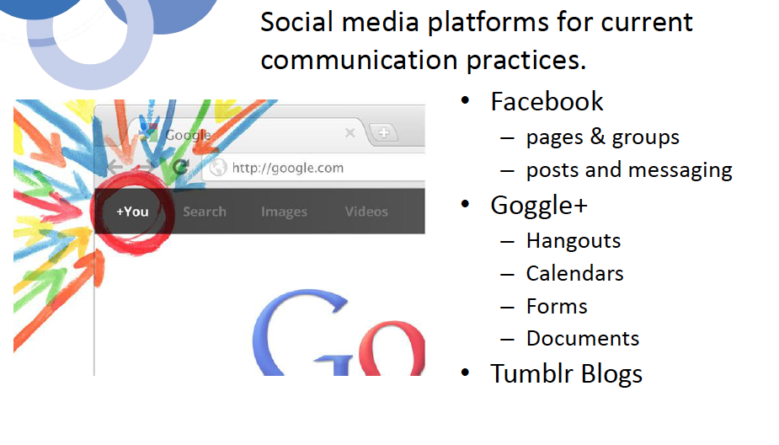

Slide 58
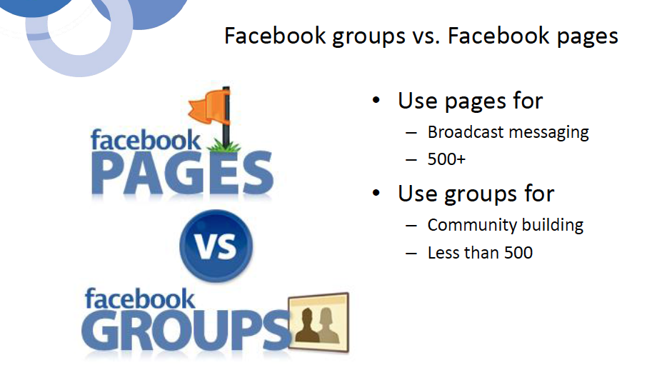

Slide 59
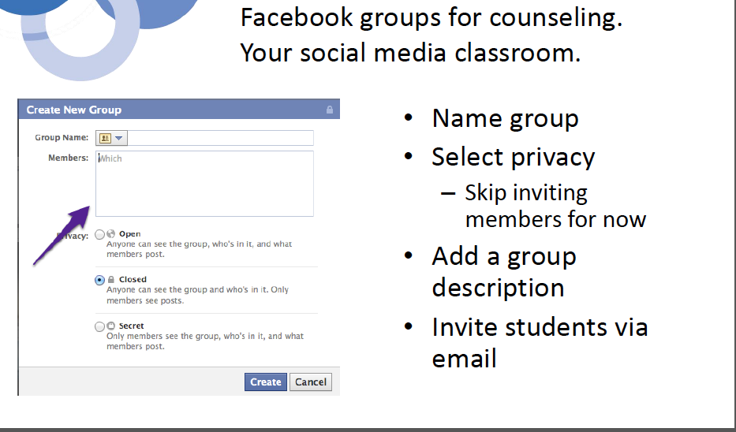

Slide 60


Slide 61
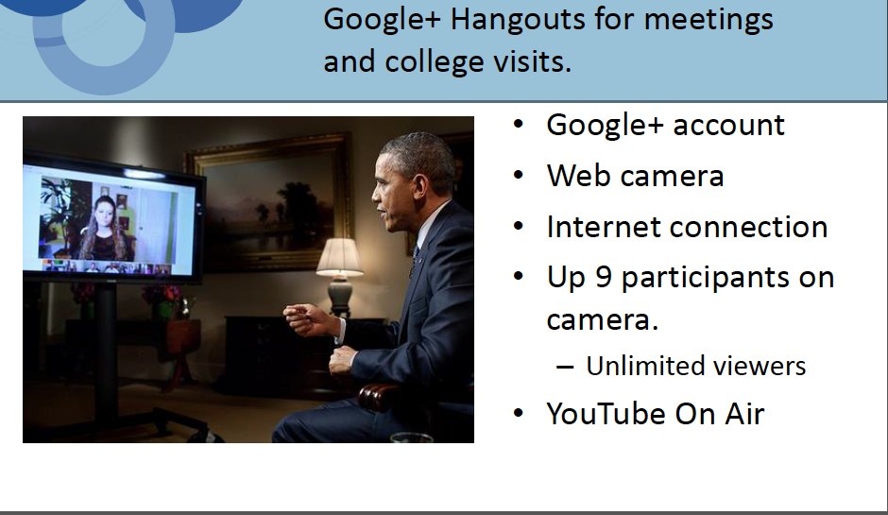

Slide 62


Slide 63
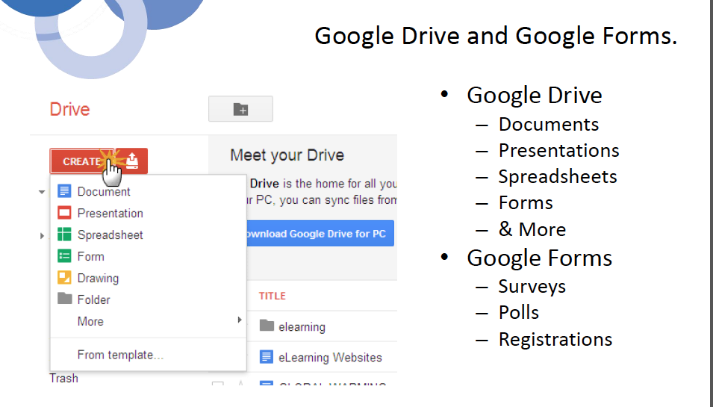

Slide 64
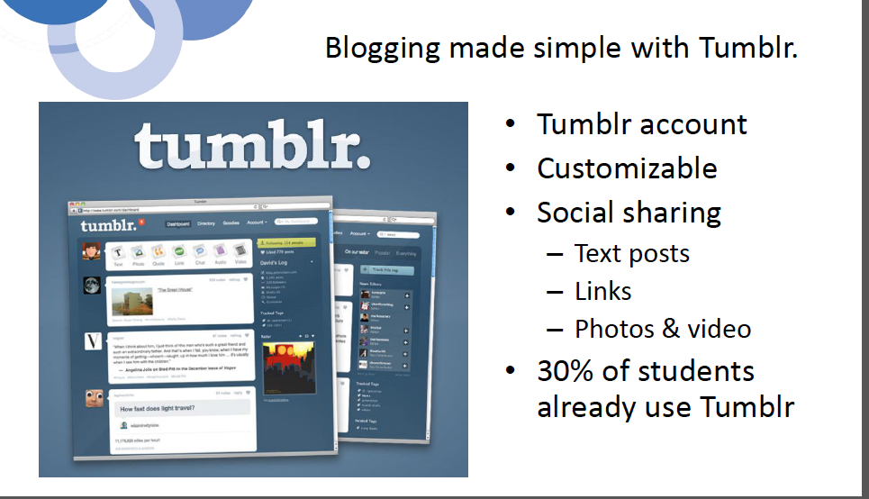

Slide 65
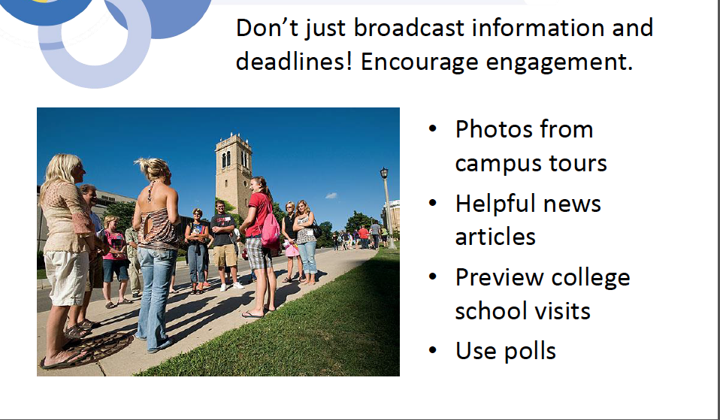

Slide 66
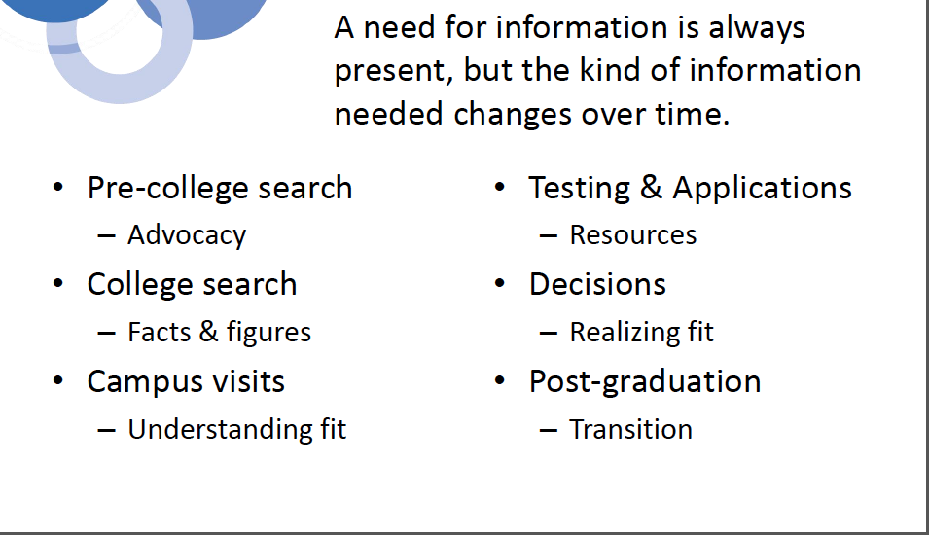

Slide 67


Slide 68


Slide 69
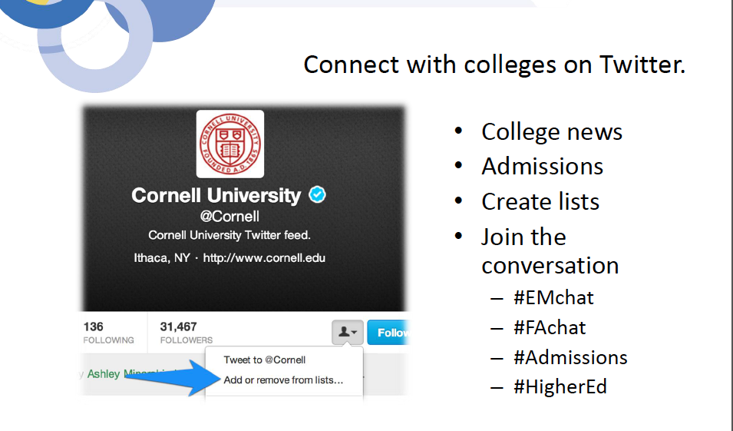

Slide 70


Slide 71
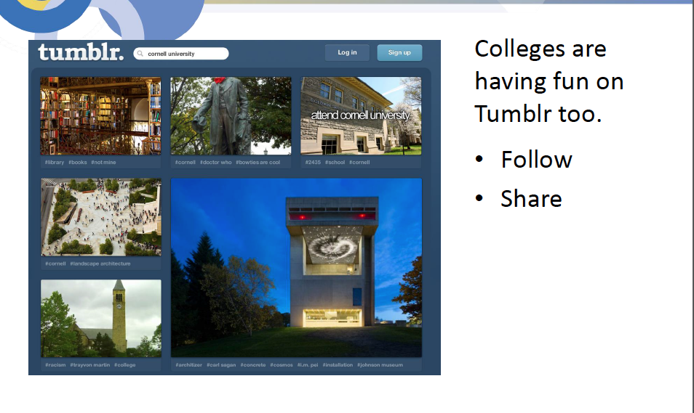

Slide 72
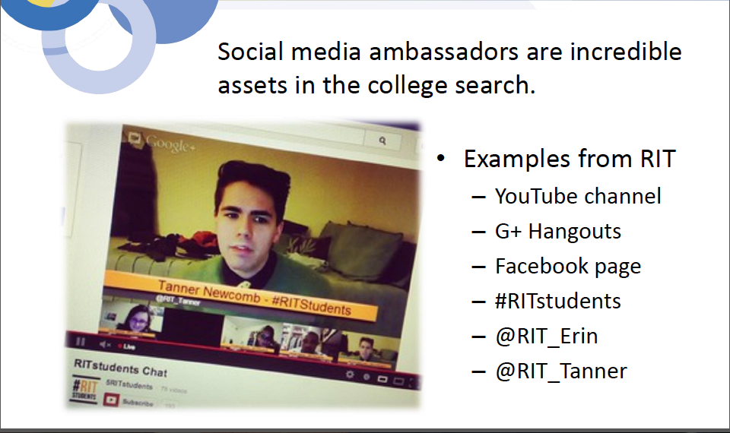
Notes:
Social media ambassadors from upper to lower levels

Slide 73
Activity: Technology in Action
Choose either YouTube, Google+ or Facebook.
For integration of career awareness, exploration, or specific pathways information exchange with students.
Create a YouTube channel, Google+ account and Hangout, or Facebook page or group.
Share the link with participants and then bring up the resource you created.
Brainstorm additional uses and applications

Slide 74

www.cte.ed.gov

Slide 75
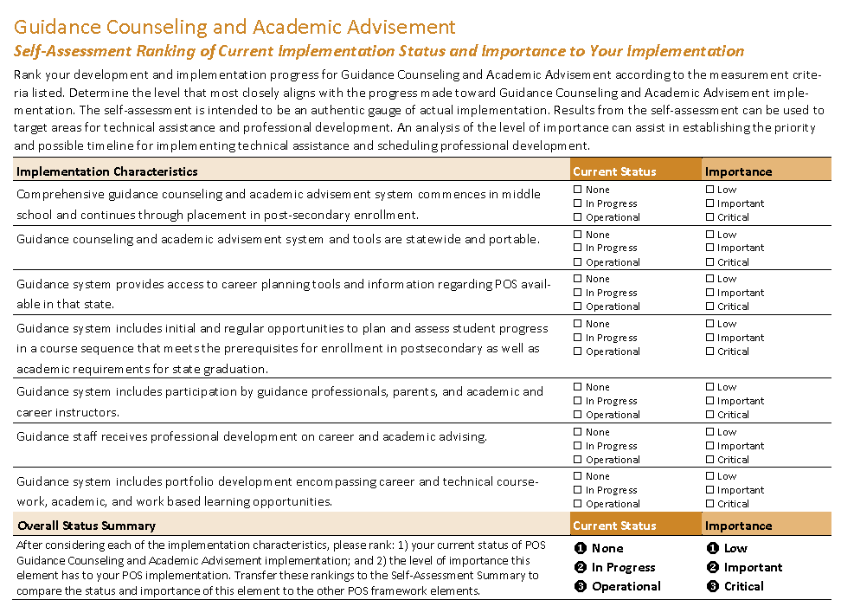
Activity – Page 6: OCTAE’s Self-Assessment

Slide 76
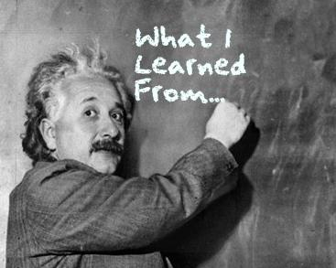
Planning & Next Steps
Take what you learned from:
Your Activities today
  Involvement of different groups
  Adult Educational Functioning Level Survey
  Other Activities: Counseling tools & resources
Promising Practices
OCTAE’s Self-Assessment

Slide 77
List your “priorities” for Transitioning to a Career Pathways ALL-IN System
Next Steps
1.
2.
3.
Professional Development Needed
1.
2.
3.

Slide 78
What’s Next?
Revisit your Action Plan and with this new information plan next steps
Report outs
  What is missing?
  Where are the gaps?

Slide 79
Resources & Questions
Michelle Carson
785.250.1882
michelle@carsonct.com
Libby Living-Eassa
772.559.8011
Libby.livings-eassa@thedivergentgroup.com

